Slide 1
Advanced Topics in Aspect-Oriented Languages:
AspectJ Programming Language

Slide 2
Spring AOP
-complements inversion of control component with AOP middleware
-to provide declarative enterprise services
-such as declarative transaction management
-uses AspectJ pointcut language
-implemented using run-time proxies
-implemented in pure java
-no special compilation is necessary
-problem accessing fine grained objects, especially domain objects
-no field access or method call options,… (need to use AspectJ instead,..)
-requires Spring interface to be used
-to process anything under the reach of Spring container not more

Slide 3
Architecture based on Aspects
Architecture is described in files
Architecture is improved – is in code
Is expressed also with pointcuts
Behaviour is added to specific parts of program thanks to aspect orientation
STRENGTHS:
Architecture is not in documentation, but in code
Solutions to problems preventing tangled and scattered code

Slide 4
Steps in defining the Architecture
1. Defining the architecture through pointcuts in place of join points
  For service -> @Service
  For repository -> @Repository
  For komponent -> @Component
2. Defining behaviour using advices
3. Assigning advices to particular join points
Result: Reduction of technical boiler plate code
-> cleaner codebase

Slide 5
Define Rules For Services And Repositories
public class SystemArchitecture {
//PRE REPOZITARE
@Pointcut(
//HOCIJAKA TRIEDA ANOTOVANA AKO @Repository
"execution(* (@org.springframework.stereotype.Repository *).*(..))"
)
public void Repository() {}
//PRE SLUZBY
@Pointcut(
//HOCIJAKA TRIEDA ANOTOVANA AKO @Service
"execution(* (@org.springframework.stereotype.Service *).*(..))"
)
public void Service() {}
}

Slide 6
Advices
-modelled as interceptor
-in chain of such interceptor around particular join point
BEFORE
AFTER RETURNING
AFTER
AFTER THROWING
AROUND

Slide 7
Before Advice in Spring AOP
@Component //SIMILARLY IT MUST BE SPRING BEAN - ASPECT IS SPRING BEAN!!!
@Aspect
public class TracingAspect {
Logger logger = Logger.getLogger();
@Before(
"execution(void doSomething())"
)
public void entering(JointPoint joinPoint) {
logger.trace("entering “
// FINDING OUT WHICH CLASS AND METHOD WAS CALLED + joinPoint.getStaticPart().getSignature().toString());
}
}

Slide 8
After Advice in Spring AOP
@Component //SIMILARLY IT MUST BE SPRING BEAN - ASPECT IS SPRING BEAN!!!
@Aspect
public class TracingAspect {
Logger logger = Logger.getLogger();
@After(
"execution(void doSomething())"
)
public void entering(JointPoint joinPoint) {
logger.trace("entering “
// FINDING OUT WHICH CLASS AND METHOD WAS CALLED + joinPoint.getStaticPart().getSignature().toString());
}
}

Slide 9
Around Advice in Spring AOP
@Component
@Aspect
public class TracingAspect {
Logger logger = Logger.getLogger();
@Around(pointcut =
"execution(* *(..))",
)
public Object traceMethod(ProceedingJoinPoint proceedingJoinPoint) throws Throwable {
String methodInformation = proceedingsJP.getStaticPart().getSignature().toString();
logger.trace("Entering method: " + methodInformation);
try {
return proceedingJoinPoint.proceed();
} catch (Throwable ex) {
logger.error("Exception occurred in: " + methodInformation, ex);
throw ex;
} finally { logger.trace("Exiting method: " + methodInformation); }
}
}

Slide 10
After Throwing Aspect
@Component
@Aspect
public class ExceptionLoggingAspect {
Logger logger = LoggerFactory.getLogger(ExceptionLoggingAspect.class);
@AfterThrowing(
"SystemArhitecture.Repository()
|| SystemArchitecture.Service()", throwing = "ex“ )
public void logException(Exception ex) {
logger.error("Exception", ex);
}
}

Slide 11
After Throwing Aspect
@Component
@Aspect
public class ExceptionLoggingAspect {
Logger logger = LoggerFactory.getLogger(ExceptionLoggingAspect.class);
@AfterThrowing(pointcut =
"SystemArhitecture.Repository()
|| SystemArchitecture.Service()", throwing = "ex“ )
public void logException(Exception ex) {
logger.error("Exception", ex);
}
}

Slide 12
After Returning Aspect
-executed only if function successfully returns value
-
@Component
@Aspect
public class OnReturnLoggingAspect {
Logger logger = LoggerFactory.getLogger(ExceptionLoggingAspect.class);
@AfterReturning(pointcut =
"SystemArhitecture.Repository()
|| SystemArchitecture.Service()", returning = "result" )
public void log (Object result) {
logger.info("Returned „ + result.toString());
}
}
This name has to be the same as parameter
of annotated advice
Return value goes here

Slide 13
Pointcut Language
Annotations in Pointcuts
ANNOTATED METHOD
execution(@com.package.Annotation * *(..))
ANNOTATED CLASS
execution(* (@com.package.Annotation *).*(..))

Slide 14
Pointcut examples:
Application to Methods
execution(void doSomething())
-refers to metod execution, declaration of method
-return type is void, method named doSomething, no parameters
execution(* *(..))
-uses wildcards
-* are WILDCARDS – the main strength of pointcuts
execution(* hello())
-method called hello
-without parameters
-any returning type execution(* hello(int, int))

Slide 15
Pointcut examples:
Application to Methods
execution(* hello(*))
-method called hello
-without one parameter of any type
-any returning type
execution(* hello(int, int))
-method called hello
-without two parameter where both are integers
-any returning type
execution(* hello(..))
-method called hello
-any number of parameters of any types
-any returning type

Slide 16
Pointcut examples: Application to Packages and Services
execution(int com.package.other.Service.hello(int))
- defining information about package along with class and method
- class is called Service
- package is called: com.package.other
- returning type is integer (int)
- method has exactly one parameter with integer type (int)
execution(* com.package..*Service.*(..))
- with any returning type
- with any number and type of parameters
- any service name that ends with Service (*Service)
- any class called Service from a package hierarchy starting with/rooted at com.package
-or in other subpackage from com.package --------> TWO DOTS (..)

Slide 17
Pointcut examples: Application to Packages and Services
execution(* *.*(..))
- execution of any method (.*)
  - any class
- in default package
- with any returning type
- with any number and type of parameters
execution(* *..*.*(..))
-execution of any method (the second .*)
-with any number and type of parameters (the second .., or simply (..))
-with any returning type (the first .)
-in any package (the second *)
-with any class (the third *)
-in any subpackage (the first ..)

Slide 18
Name of Beans as Pointcuts
BEAN THAT ENDS WITH Svc
bean(*Svc)
BEAN PRECONFIGURATION
1. Java Configuration
-bean annotated methods @bean
2. Annotation parameter
-@Component, @Service, @Repository
3. XML configuration
-id / name attribute

Slide 19
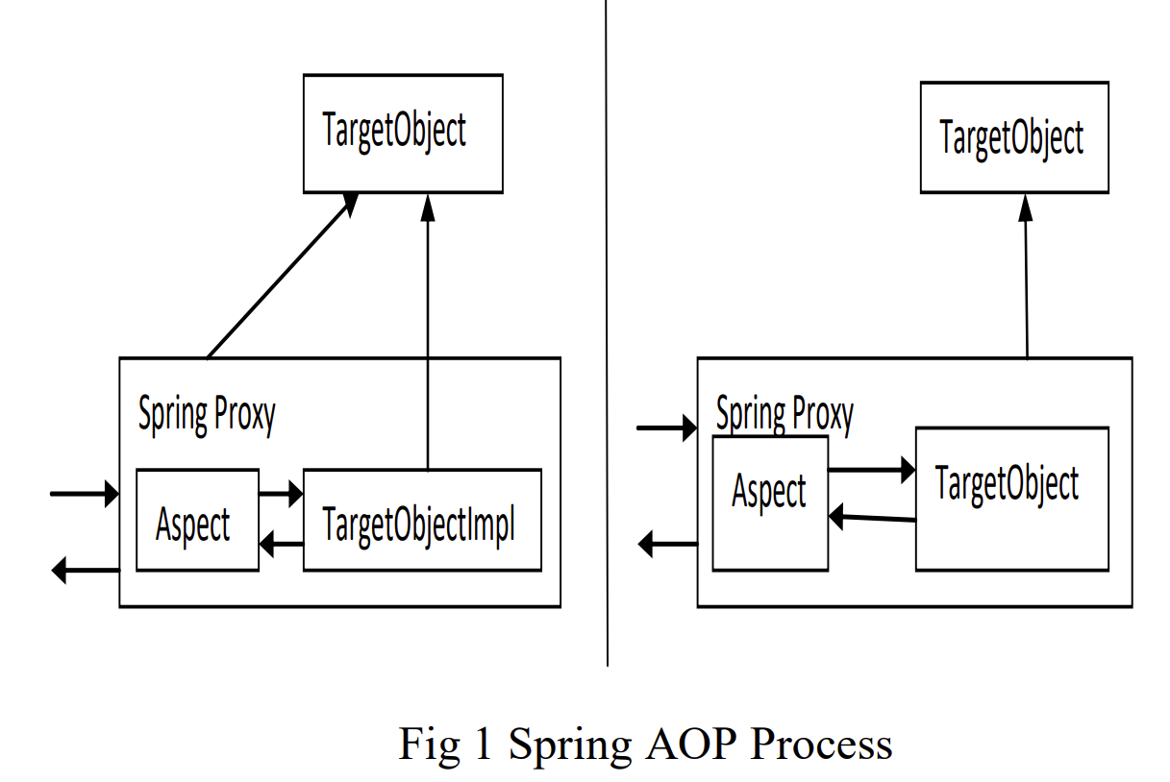
Spring AOP
Proxies
--------------------------- calling PROXY / ---------------- /
- Other Spring bean - ------> / Original object /
--------------------------- / ---------------- /
1. Getting proxy / PROXY –created by Spring
(not original object) / - as original object (looks like)
/ - injected into other Spring Beans
2. Code is directed / - dynamic proxies if interfaces are used
to original object / otherwise (in remaining cases) CGLIB generated subclasses
///////////////////////
3. Advice is called
||
\ || /
\ /
\ /
------------
- Advice -
------------

Slide 20
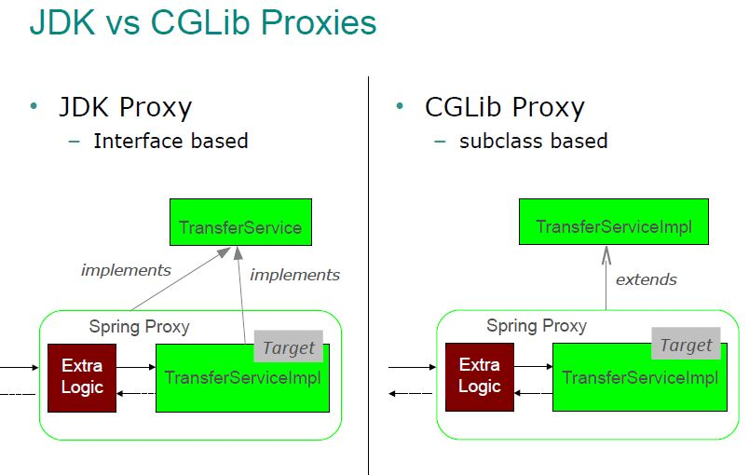
Proxy in Spring AOP:
JDK vs CGLIB
Taken from: https://i.sstatic.net/ZQkEF.jpg
-Spring AOP is implemented using run-time proxies -> object is always proxy
Weaving at runtime
From: R. Laddad, “AspectJ in Action”,
Enterprise AOP with Spring,
Manning Publications, 2010
Default and preferred way
– if interface is implemented by target object
interface is not implemented by target object

Slide 21
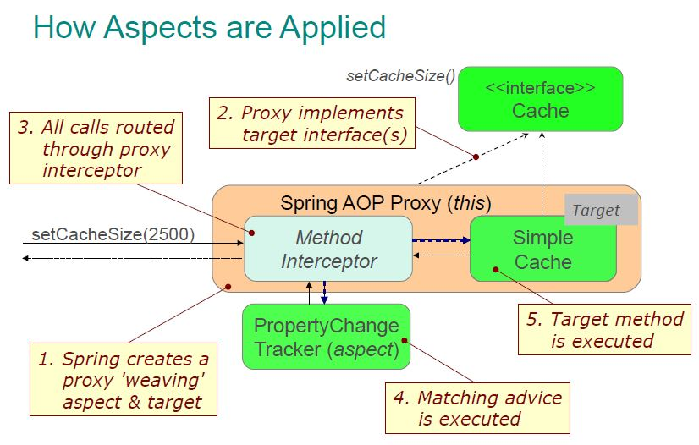
Taken from: https://i.sstatic.net/bglkX.jpg

Slide 22
Proxies in Spring AOP
Taken from: KUMAR, Ravi a Munishwar RAI, 2019. A Comparative Study of AOP Approaches:
AspectJ, Spring AOP, JBoss AOP. 2019

Slide 23
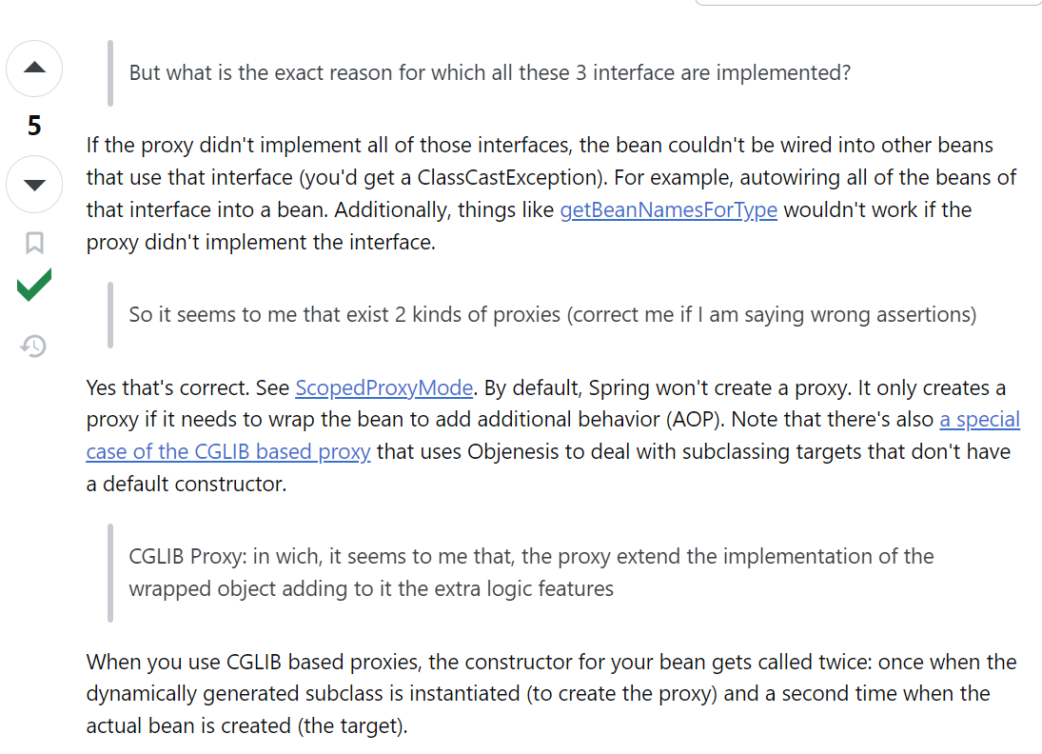

Slide 24
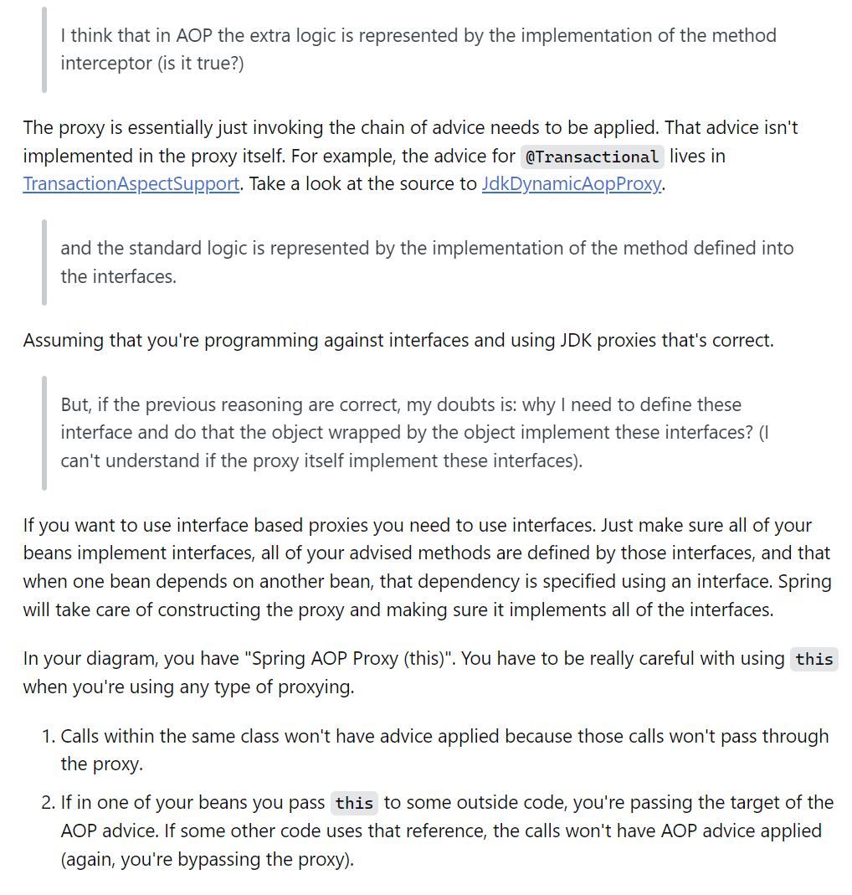
Using this you
refer to proxy

Slide 25
Pointcut Annotation
@Pointcut
public class PointcutsForCheckingOrders {
@Pointcut("execution(@annotation.Check * *(..))")
public void checkOrder() {
}
}
USAGE
@Around("PointcutsForCheckingOrders.checkOrder()")
public void check(ProceedingJoinPoint proceedingJP) throws Throwable {
}
Variant restricted to particular package:
@Around("packageName.PointcutsForCheckingOrders.checkOrder()")
public void check(ProceedingJoinPoint proceedingJP) throws Throwable {
}

Slide 26
Allowing Aspects In Configuration of Spring Framework
Option 1
<beans>
// KAZDA BEANA S ASPEKT ANOTACIAMI SA STANE ASPEKTOM
<aop:aspectj-autoproxy />
// SCAN PRE SPRING BEANY
<context:component-scan base-package="simplepackagename" />
</beans>
@Configuration
@EnableAspectJAutoProxy //ENABLES @Aspect ANNOTATION
@ComponentScan(basePackages="simplePackageName")
public class SimpleAspectConfiguration {
}
Option 2

Slide 27
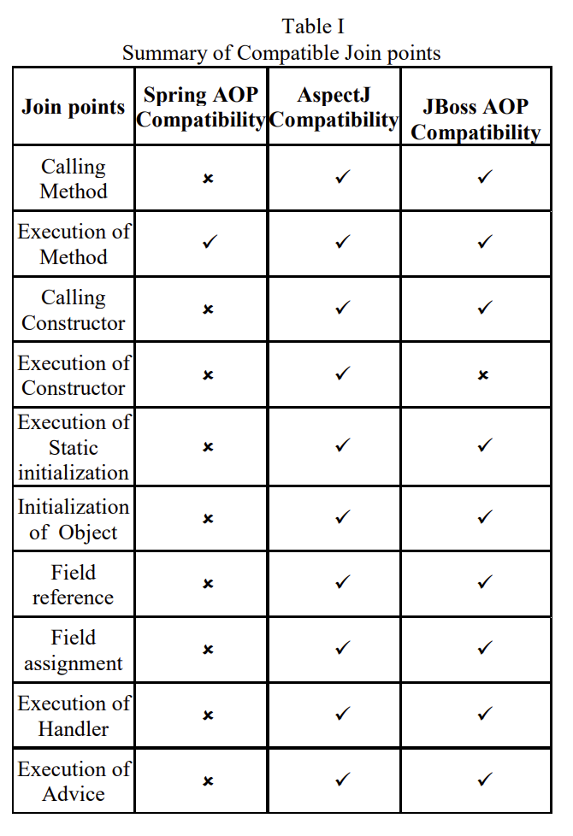
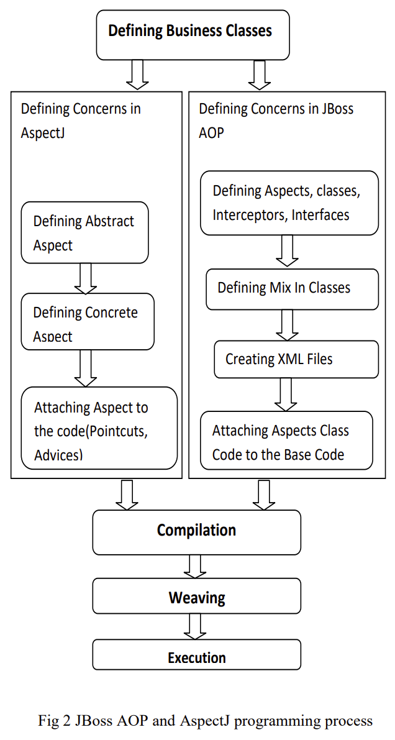
AspectJ vs Spring AOP vs JBoss
Only these method join points
are supported in Spring AOP
-> rather aiming integration
with inversion of control
component in Spring
Taken from: KUMAR, Ravi a Munishwar RAI, 2019. A Comparative Study of AOP Approaches:
AspectJ, Spring AOP, JBoss AOP. 2019

Slide 28
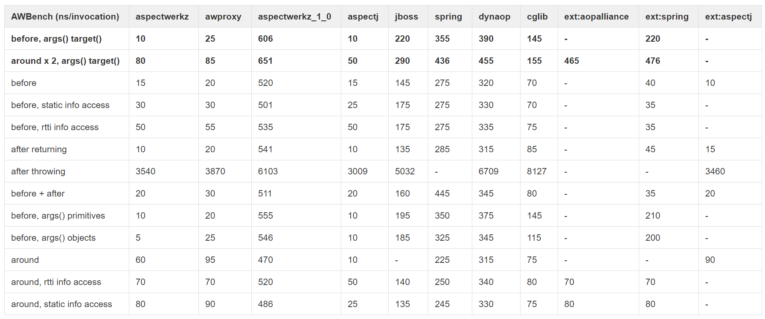
Runtime Performance
The results were obtained
with 2 million iterations. L
atest run: Dec 20, 2004
In ns - nanoseconds
Taken from: https://web.archive.org/web/20150520175004/https:/docs.codehaus.org/display/AW/AOP+Benchmark

Slide 29
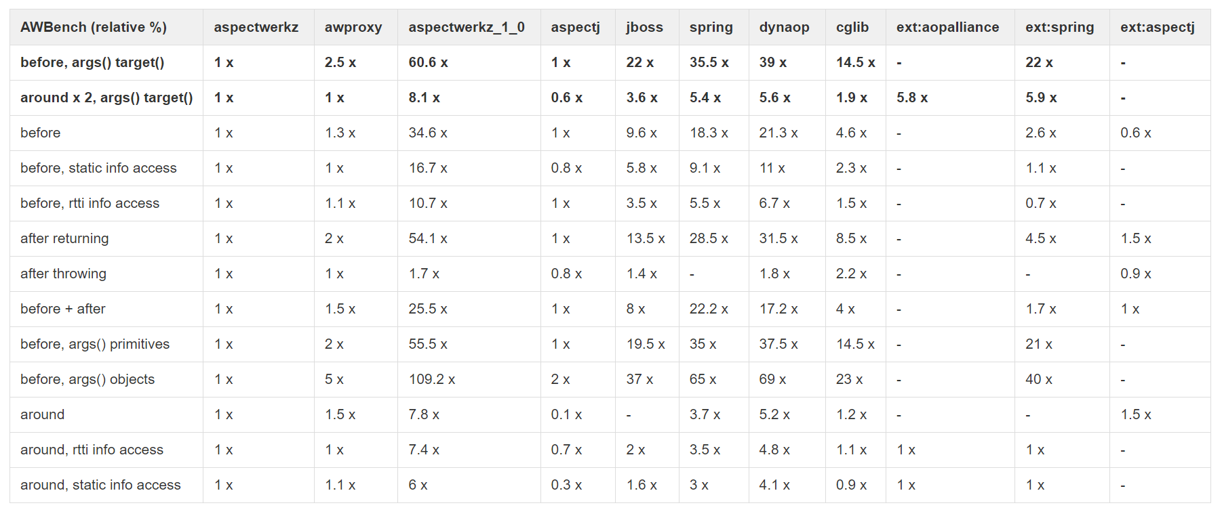
Runtime Performance
The results were obtained
with 2 million iterations. L
atest run: Dec 20, 2004
Taken from: https://web.archive.org/web/20150520175004/https:/docs.codehaus.org/display/AW/AOP+Benchmark

Slide 30
AspectJ
-the most developed aspect-oriented language
-much faster compile-time weaving is used as default to weave aspects
-no additional run-time overhead
-own pointcut language
-all types ow weaving are supported

Slide 31
Pointcuts – different kinds
Annotation based pointcuts
Method/constructor call
Method/constructor execution
Execution object pointcuts
Control flow based pointcuts
Argument pointcuts
Initialization
Field Access
Exception Handling
Advice execution
Conditional pointcut
Pointcut based on Lexical structure

Slide 32
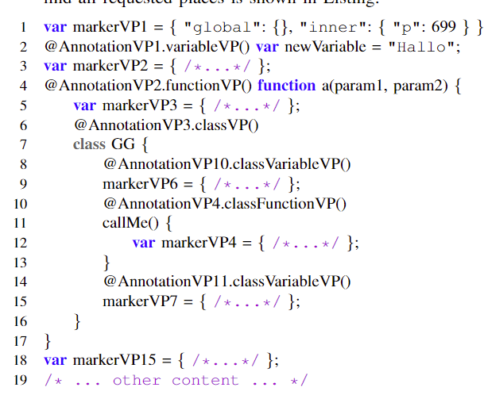
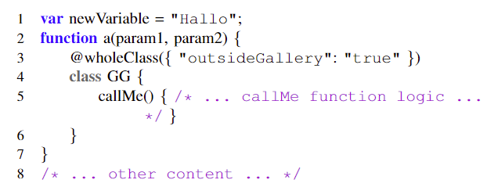
Example: Annotation based join points
Automated pointcut extraction
with semantic information

Slide 33
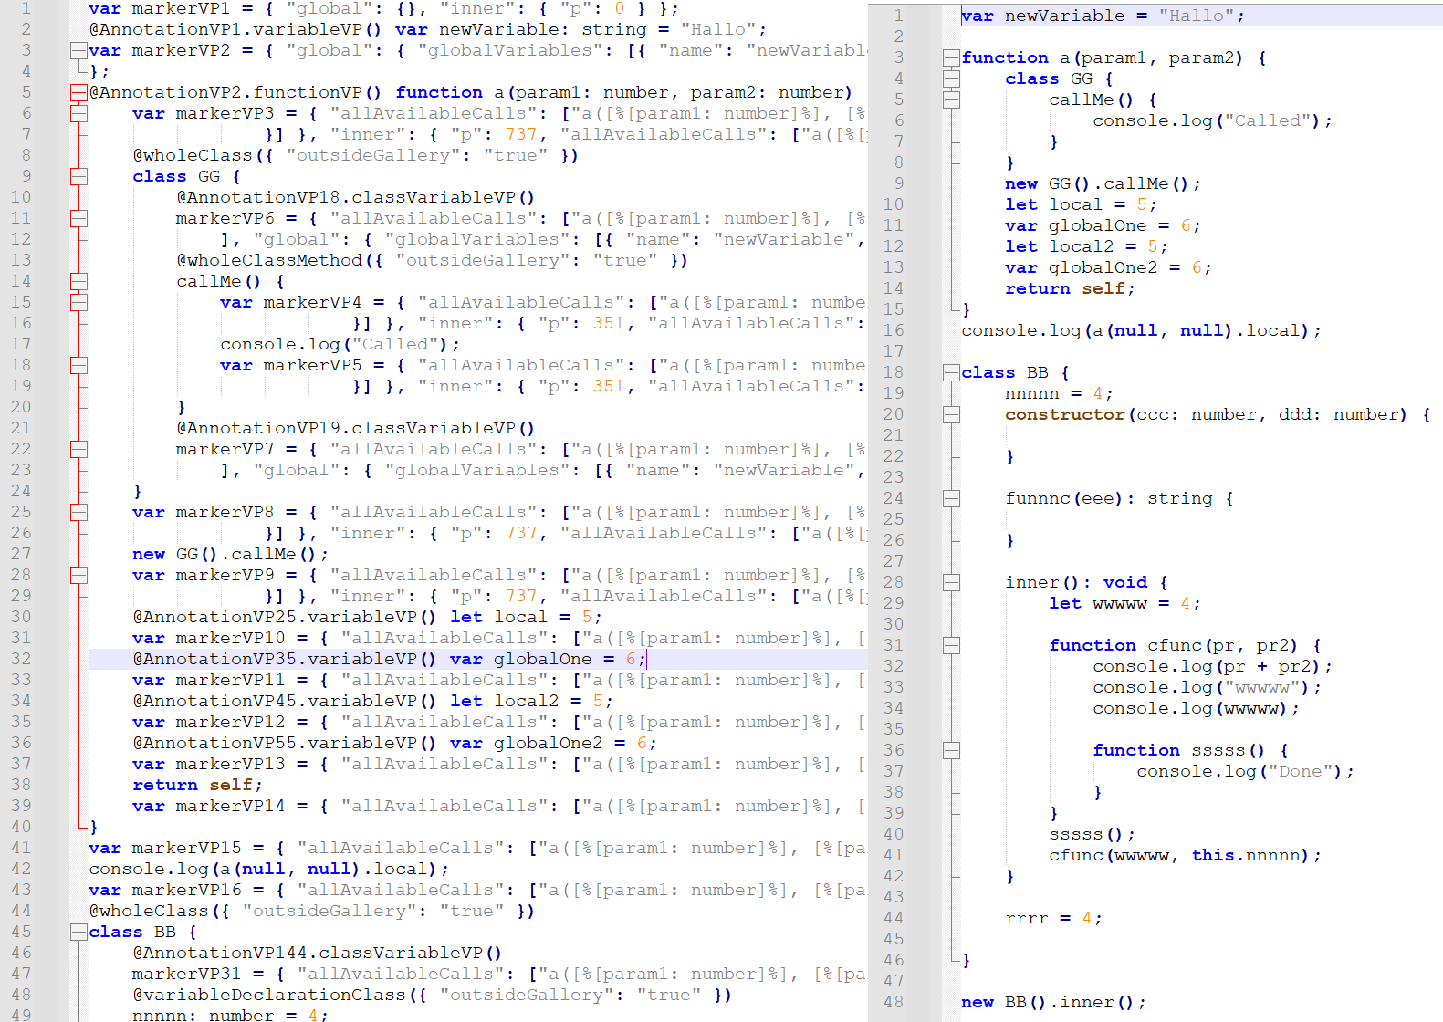

Slide 34
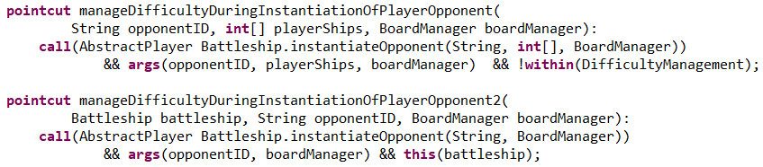
Pointcut
-selects sets of join points and collects context in their place
Example
To capture constructor call, when Player instance is going to be created
call(Player.new(..))
To check condition (for example for variability handling)
To capture constructor call, when Player instance is going to be created,
but setNames from Configuration has to be true
call(Player.new(..)) && if(Configuration.setNames);
Complex examples with whole declaration (within aspect):

Slide 35
Pointcut language
call(Player.new(..))
Any number, name, and type of arguments
Player class
is called
To capture
constructor
execution(Player.new(String))
Player class
is executed
To capture
constructor
With one argument from which the first one has type String

Slide 36
Control flows
Capturing join points in particular control flows
Any return type
cflow(call(* Post.fileLetter()))
cflowbelow(call(* Post.fileLetter()))
Other example: cflowbelow(execution(* Post.fileLetter()))

Slide 37
Pointcuts Based on Lexical Structure
Inside its lexical structure
Type of something
– in form of pattern
Signature of something
– in form of pattern
within(Post)
withincode(* Post.fileLetter())
-join points contained within
particular entity – aspect or class
Example within(Post)
– all join points within Post class
-join points contained within
particular code – constructor or method
Example within(* Post.fileLetter())
– all join points within fileLettter() method of Post class

Slide 38
Execution Object Pointcuts
Treats types of objects during the execution
No wildcards!!!
Type or Object
Type or Object
this(Post)
Not matching static methods!!!
target(Post)
-this is instance of particular Type
Example this(Post)
– all join points that are instances of Post class
-target is instance of particular type
Example target(Post)
– object on which methods are called is type of Post - all such join points

Slide 39
Arguments Pointcuts
In accordance with type and number of arguments
TypePattern or Object
args(double, String)
-arguments matching with type and number
– all join points where the first argument is double and second is String
args(double, ..)
-first arguments matching required types and other are optional and not restricted in their number and type
– all join points where the first argument is double and other are optional

Slide 40
Conditional Checkpoints
Conditional checking
Boolean Expression
Idiom/programming tip:
Nullify the advice:
if(true)
if(false)
-checks if Boolean expression matches
–all join points where condition is true
if(Timer.time() > 10)
-checks if time is higher then 10
– all join points where time is higher than 10

Slide 41
Introduction
-a static crosscutting instruction
-to introduce relation such as specialization
Example [USED FOR EXAMPLE JUST TO MARK SOME
CLASSES FOR FURTHER PROCESSING]:
declare parents: Human implements TaxDodger;
declare parents: Human extends RichTaxDodger;

Slide 42
Exception Softening
-softens exception: allows to treat checked exception as unchecked one
Checked Exception – caller must catch it or declare to throw it
Example:
declare soft: IllegalStateException: call(* changeState(..));

Slide 43
Precedence
-changing a precedence of aspects
Example: changing precedence of aspects from
MyAspect1 >> MyAspect2 >> MyAspect3
to
MyAspect3 >> MyAspect1 >> MyAspect2
declare precedence: MyAspect3, MyAspect1, MyAspect2;

Slide 44
Precedence
Use of wildcards causes errors in case of circular dependence!!!
-changing a precedence of aspects
-useful to handle overloading during use of intertype declaration where the variables are the same
Example: changing precedence of aspects from
MyAspect1 >> MyAspect2 >> MyAspect3 >> MyExclusiveAspect1
to
MyAspect3 >> MyAspect1 >> MyExclusiveAspect1 >> MyAspect2
wildcard
declare precedence: MyAspect3, MyAspect1, MyExclusiveAspect*, MyAspect2;

Slide 45


Difficulty configuration
Prepare configuration (with difficulty settings) before creating player’s specific instance
1. PREPARATION
2. POINTCUTS
The same pointcuts
(with other names)
“Hook“ functions

Slide 46
Compile-time declaration
-a static crosscutting instruction
-to introduce compile time warnings and errors to warn or prevent
some unwanted development practices
Example [TO PREVENT AND CHECK UNWANTED DEVELOPING PRACTICES]:
-a compiler warns when any of System.print or System.println method is used
declare warning: call(void System.out.print*(..)) :
"Do not output directly to the console. Use logger instead!";
Example throwing an error
declare error: call(void System.out.print*(..)) :
"Do not output directly to the console. Use logger instead!";

Slide 47
Policy Enforcement
-Improving reusability
-Untangling policy code with source code
-Preventing scattering of policy code
-Easy application of policies
Compile-time
Run-time
declare warning: call(void System.out.print*(..)) :
"Do not output directly to the console. Use logger instead!";
declare error: call(void System.out.print*(..)) :
"Do not output directly to the console. Use logger instead!";

Slide 48
Example: Intertype declaration in AspectJ
Extends Player class with variable
called name with String type
public aspect PlayerName {
private String Player.name;
private void Player.setName(String playerName) {
  this.name = playerName;
}
private String Player.getName() {
  return this.name;
}
Extends Player class with function
setName(String playerName)
Extends Player class with function
getName()
Possibly to set up functionality additively and incrementally,
only empty classes that will be extended are required.
}

Slide 49
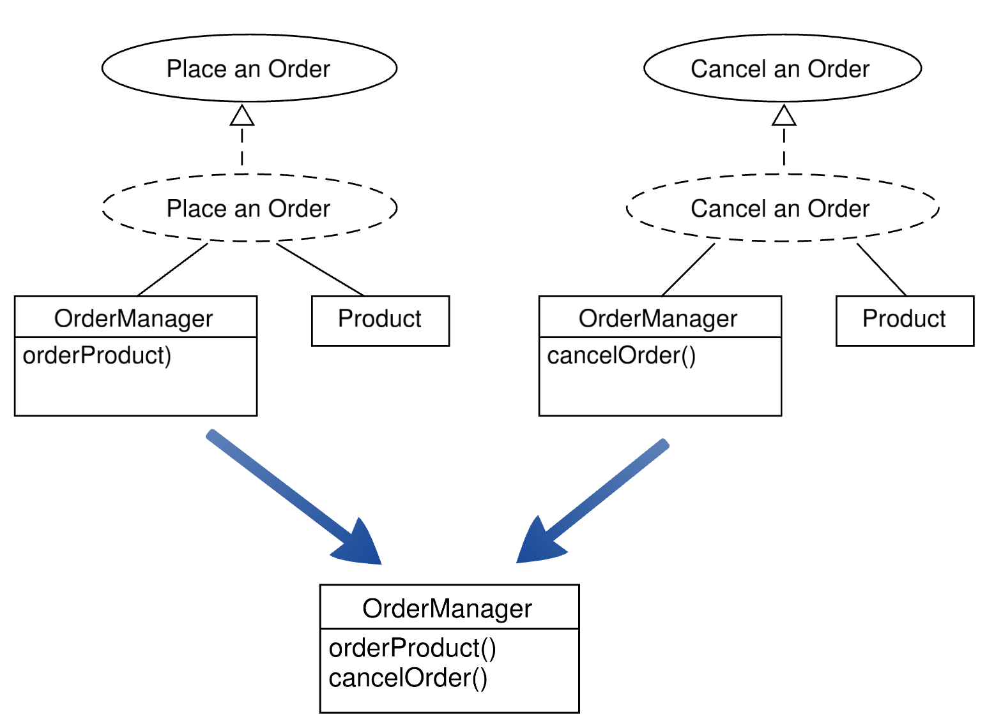

Slide 50
Example: Aspect in AspectJ
public aspect PlayerName {
Player around(): call(Player.new(..)) && if(Configuration.setNames){
  Scanner reader = InputReader.getReader();
  System.out.println("Set player name:");
  String playerNameLine = reader.nextLine().replace("\n", "");
  Player createdPlayer = proceed();
  createdPlayer.setName(playerNameLine);
  System.out.println(createdPlayer.getName());
  return createdPlayer;
}
}

Slide 51
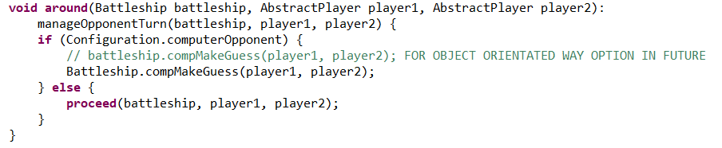
A Complex Pointcut With Advice

Slide 52
Advice
  - The advice is the action and decision-making part which it allows for the
  expression of intersecting action at the joining point (Laddad 2003).
  Point connection is captured by the corresponding pointcut. It is implemented
  as construction in the form of a method called before (before), behind (after)
  or wrapping (around) the specified join point.
  - To express modification of original code
Player around(): myPointcut {
  Scanner reader = InputReader.getReader();
  System.out.println("Set player name:");
  String playerNameLine = reader.nextLine().replace("\n", "");
  Player createdPlayer = proceed();
  createdPlayer.setName(playerNameLine);
  System.out.println(createdPlayer.getName());
  return createdPlayer;
}

Slide 53
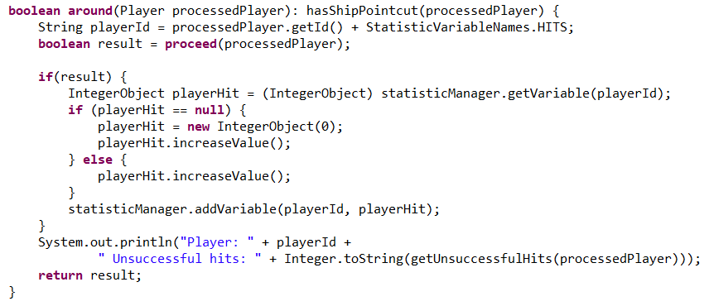
Advice Structure
Pointcut reference
or specification
Advice type
Advice
body

Slide 54
Around Advice
Player around(): myPointcut {
  Scanner reader = InputReader.getReader();
  System.out.println("Set player name:");
  String playerNameLine = reader.nextLine().replace("\n", "");
  Player createdPlayer = proceed();
  createdPlayer.setName(playerNameLine);
  System.out.println(createdPlayer.getName());
  return createdPlayer;
}

Slide 55
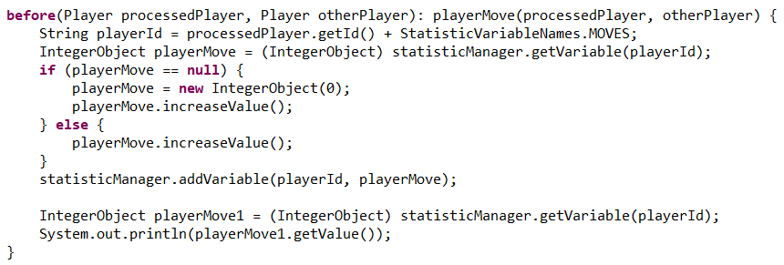
Before advice

Slide 56
Reflective API - AspectJ
-information about join point
thisJoinPoint
thisJoinPointStaticPart
-dynamic information about join point:
-method arguments
-information about target object
-information about execution object
- static information can be reached by
calling getStaticPart()
-static information about join point:
-source location
-information about kind of
method execution/call, field-set,…
-join point signature
provides structural context information
about join point
thisEnclosingJoinPointStaticPart
-information about enclosing join point (enclosing context)
-depends on join point [enclosing – surrounding]:
call of method – enclosing context is execution of caller method

Slide 57
Association of Aspects in AspectJ
Per Virtual
Machine
Per Object
Per Control
Flow
-association with object
-default association
-association with control flow
-to manage states/data in particular
control flow

Slide 58
Per Object Aspect Association
perthis(myPointcut())
pertarget(myPointcut())
-separate aspect instance is associated with this
object for all join points matching
pointcut myPointcut())
-separate aspect instance is associated with target object for all join points matching
pointcut myPointcut())
-to define specifics later
-association with object
public abstract aspect MyAspect perthis(myPointcut()) {
abstract pointcut myPointcut();
}
-the specific pointcut should be provided in inherited aspect

Slide 59
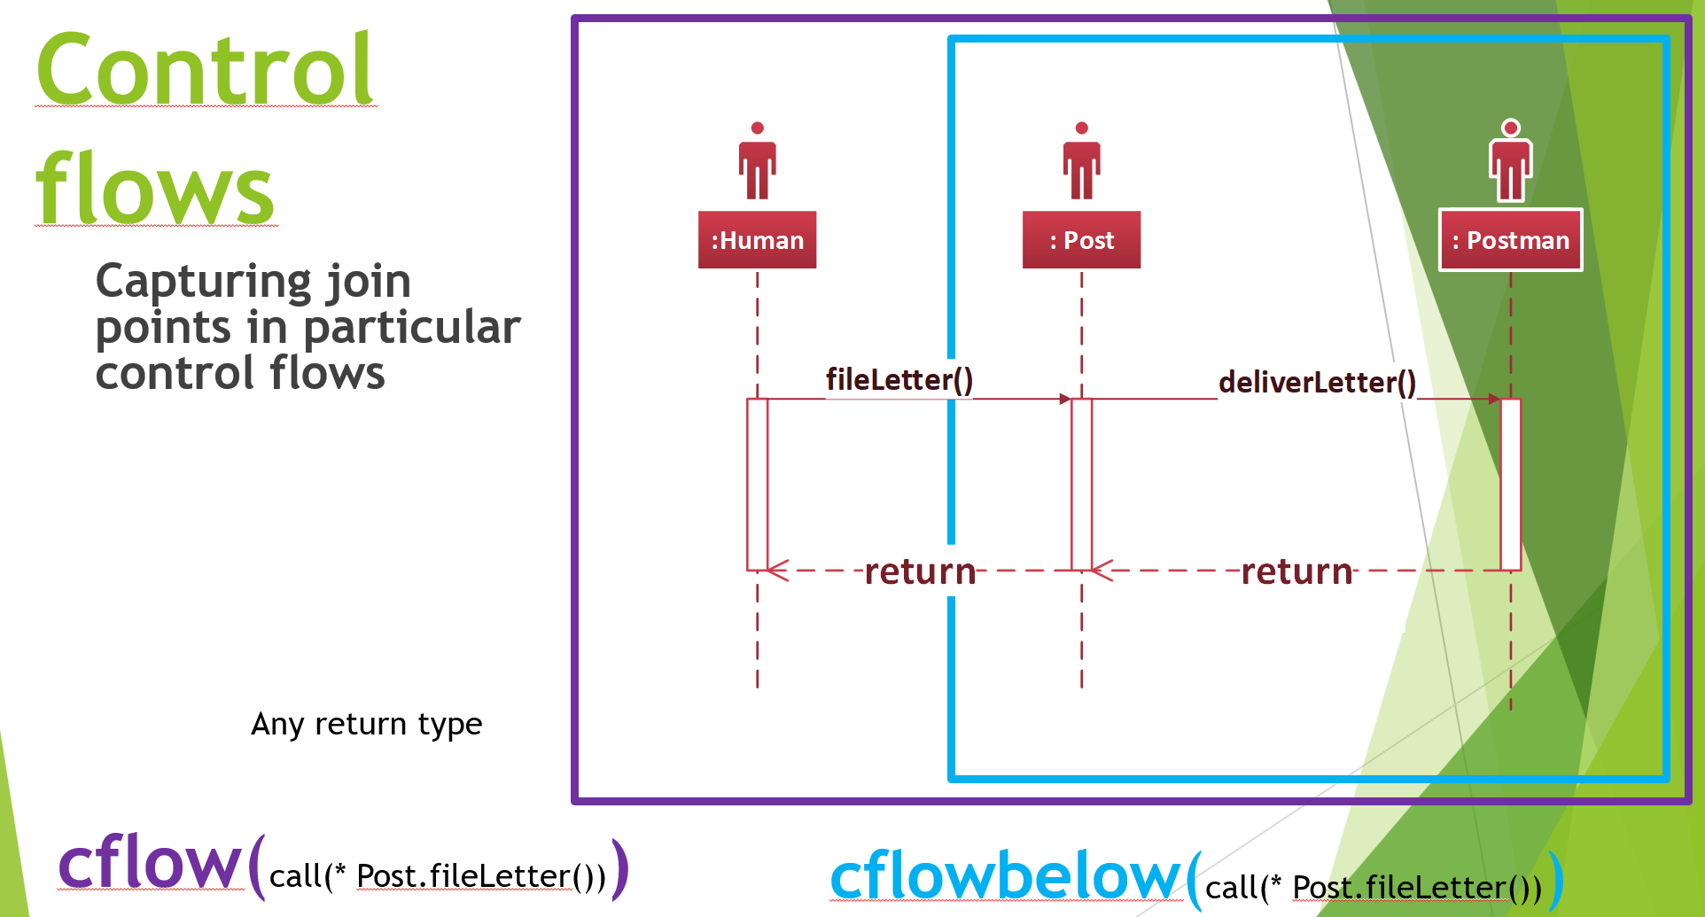
Per Control Flow Aspect Association
percflow(myPointcut())
percflowbelow(myPointcut())
-separate aspect instance is associated with the control flow at join points matching
pointcut myPointcut()
-separate aspect instance is associated with control flow below at join points matching
pointcut myPointcut()
-to define specifics later
-association with object
public abstract aspect MyAspect percflow(myPointcut()) {
abstract pointcut myPointcut();
}
-the specific pointcut should be provided in inherited aspect

Slide 60
Privileged Aspect - AspectJ
-to access private variable or method which is declared In particular class
privileged public aspect PlayerName {
private String Player.name;
private void Player.setName(OtherPlayer oPlayer) {
  this.name = oPlayer.privatePlayerName;
}
private String Player.getName() {
  return this.name;
}
}

Slide 61
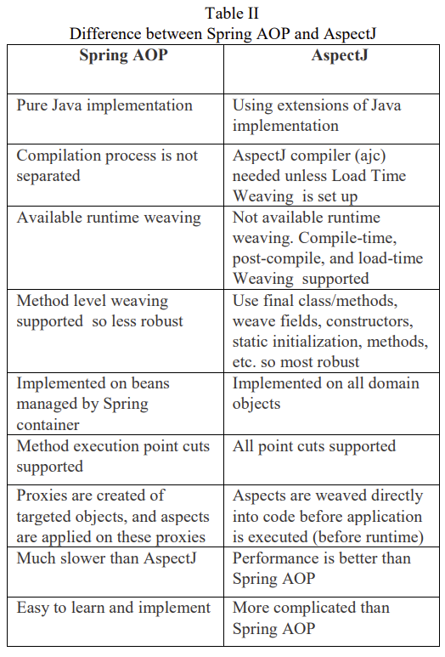
Spring AOP vs AspectJ
Taken from: KUMAR, Ravi a Munishwar RAI, 2019. A Comparative Study of AOP Approaches:
AspectJ, Spring AOP, JBoss AOP. 2019

Slide 62
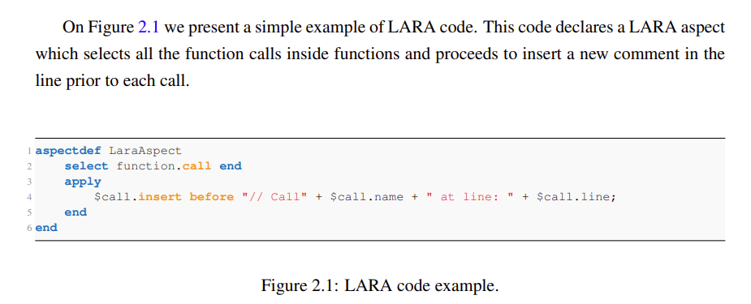
LARA – language independent aspect-oriented programming
-example of DSL (domain specific language)
-generic source code transformation and analysis
JackDaw: https://specs.fe.up.pt/tools/jackdaw/
Independence on programming language:
thanks to separation of the LARA language from the language specification of the target language,
which consists of a specification of relevant points of interest, along with their attributes and actions
Source-to-source transformations
Taken from: SÁ LOUREIRO
FERREIRA DA SILVA, Ricardo, 2019. Aspect-Oriented Programming for Javascript using the Lara Language. Porto. Dissertation thesis. Universidade do Porto.

Slide 63
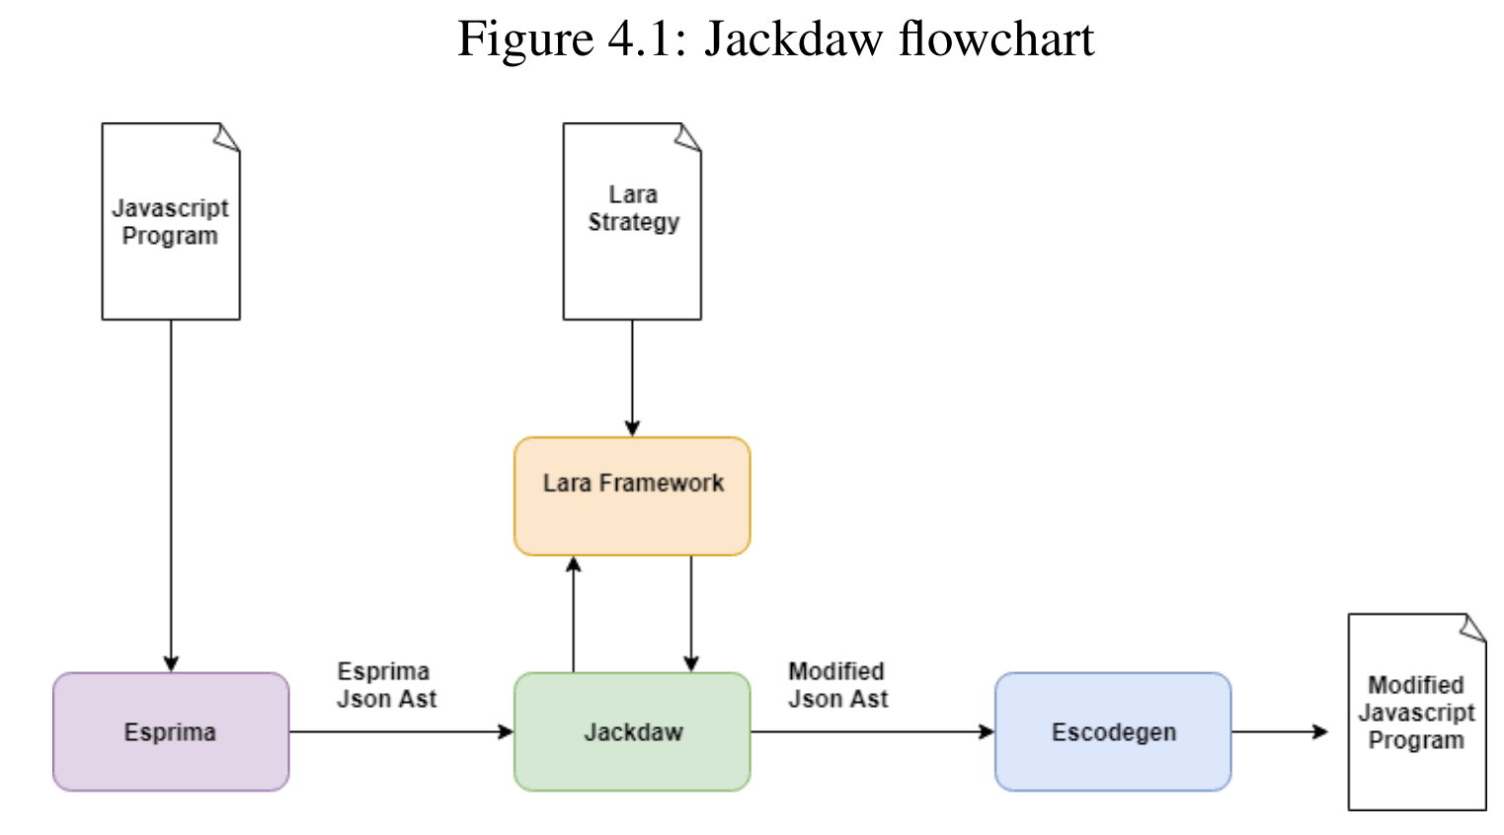
Taken from: SÁ LOUREIRO
FERREIRA DA SILVA, Ricardo, 2019. Aspect-Oriented Programming for Javascript using the Lara Language. Porto. Dissertation thesis. Universidade do Porto.

Slide 64
Approach - flow
1. Parsing of JavaScript code into AST – Esprima (high performance, standard-compliant ECMAScript parser written in ECMAScript)
  Tokenizing and parsing JavaScript into AST - JSON object (all used structures and hierarchies optionally with comments, location of nodes,…)
  Lack of JavaScript parsers in JavaScript – some exists like Rhino or Java 8 Nashorn Javascript engine
2. Creation of JackDaw join points
  JavaScript language structures and statements present in the source code:
    declarations, while statements, if statements, try-catch statements, etc
  Operable/supported join points used as (see following examples):
    project, file, functionDeclaration, classDeclaration, declaration, forStatement, whileStatement, switchStatement, ifStatement, tryStatement and expressionStatement.
  Each is mapped to Java class where node is queried internally
    Results in performed actions and returned respective attributes (from the weaver language specification)

Slide 65
Approach - flow
3. Executing LARA code (LARA selector language)
  to query for a particular type of join point
    Respective object in AST must be searched and applied (wrapped) to particular type of join point
    Generic join point:
      In case of no such type of join point – its wrapped around generic join point (with methods common to every type of such join points)
      For join point attributes that return another join point (to wrap JSON nodes to already undefined join points)
  Querying and capturing the JackDaw join points
3. Weaving aspects into AST using Jackdaw
  interacting and applying actions to AST ordered by LARA framework
  Using Jackdaw Query Engine for searche operations
    getting the parent of a join point, getting all child nodes, descendant nodes, nodes of particular type, etc.
4. Transformation of updated AST back to JavaScript code - Escodegen library(ECMAScript code generator from Mozilla’s Parser API AST)
  Allows to customize formatting of the transformed/generated code
  Performed by JackDaw

Slide 66
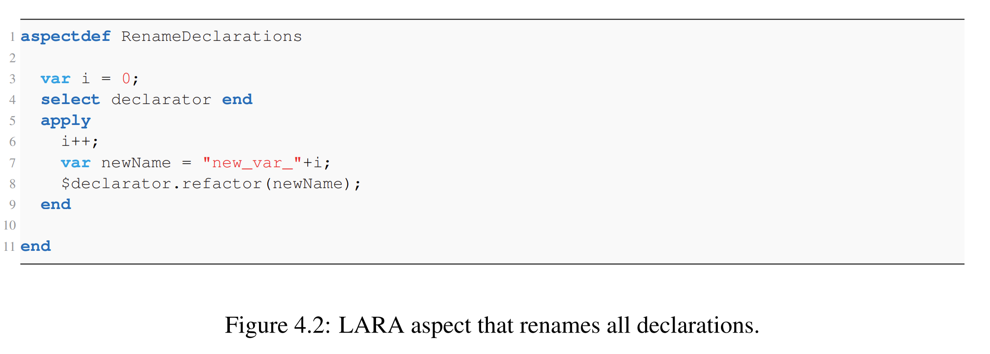
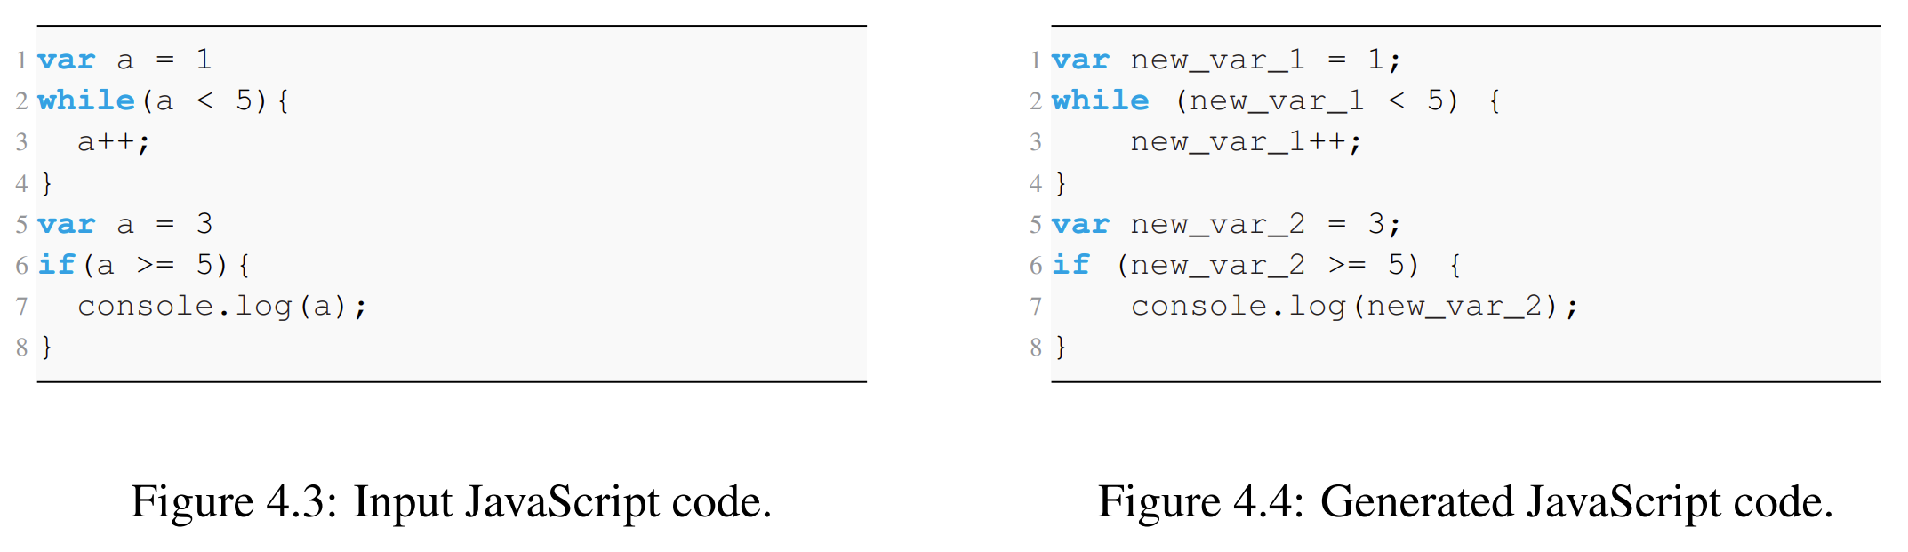
Tests: Obfuscation
Variable renaming
Taken from: SÁ LOUREIRO FERREIRA DA SILVA, Ricardo, 2019. Aspect-Oriented Programming for Javascript using the Lara Language. Porto. Dissertation thesis. Universidade do Porto.

Slide 67
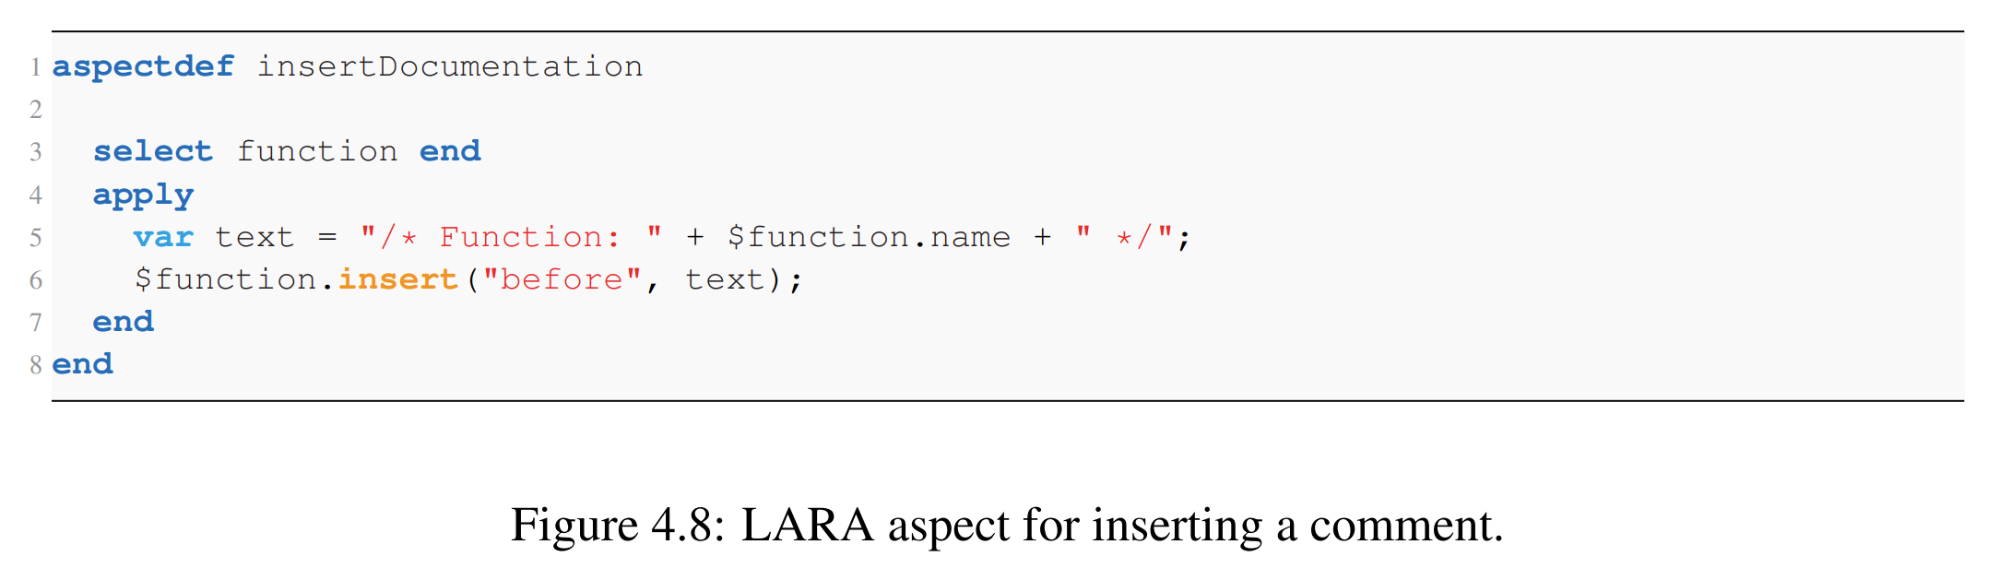
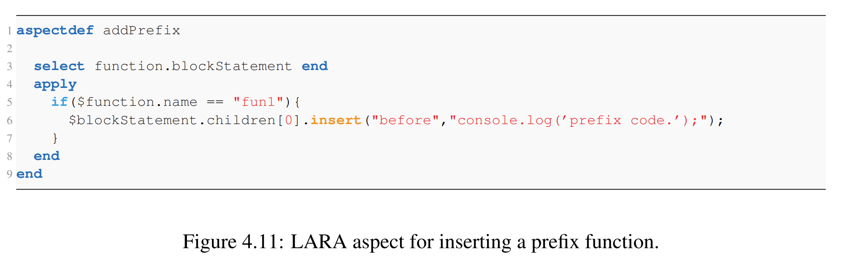
Features
Taken from: SÁ LOUREIRO FERREIRA DA SILVA, Ricardo, 2019. Aspect-Oriented Programming for Javascript using the Lara Language. Porto. Dissertation thesis. Universidade do Porto.

Slide 68
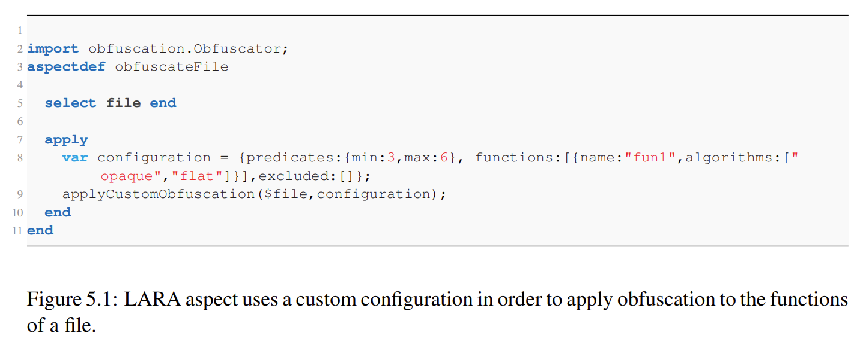
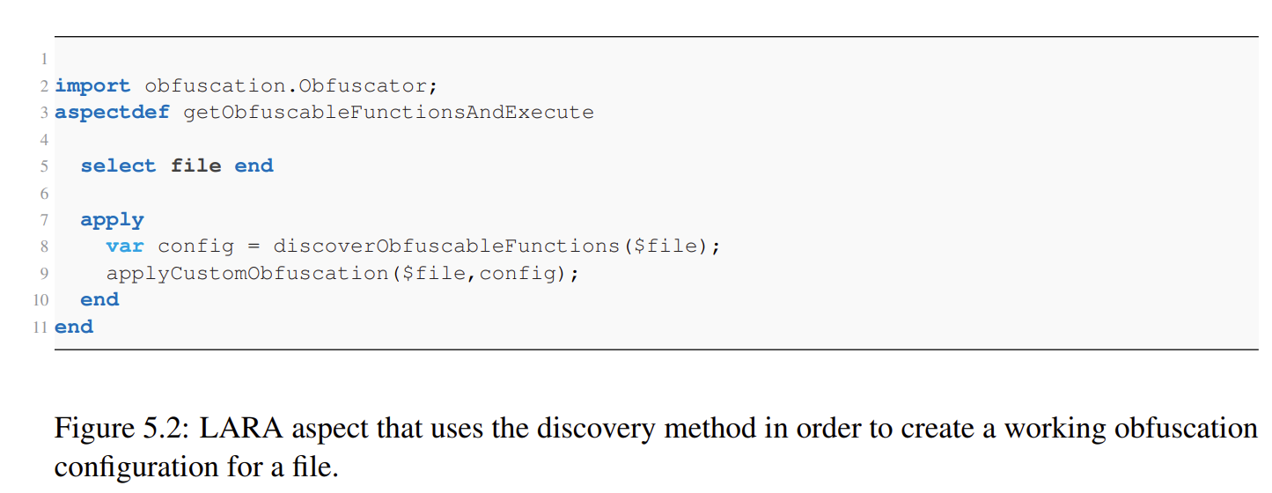
Taken from: SÁ LOUREIRO
FERREIRA DA SILVA, Ricardo, 2019. Aspect-Oriented Programming for Javascript using the Lara Language. Porto. Dissertation thesis. Universidade do Porto.

Slide 69
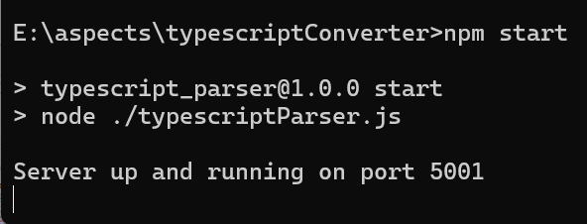
Sample JavaScript/TypeScript AST
Abstract syntax tree (AST)
Available as part of NodeJS - Express JS API:
https://github.com/jperdek/variabilityMgmtCodeConstructsComplexity/tree/
master/astConverterAndComplexityEvaluator
Unpack it!!!
cd pathTo/astConverterAndComplexityEvaluator
npm install
npm start

Slide 70
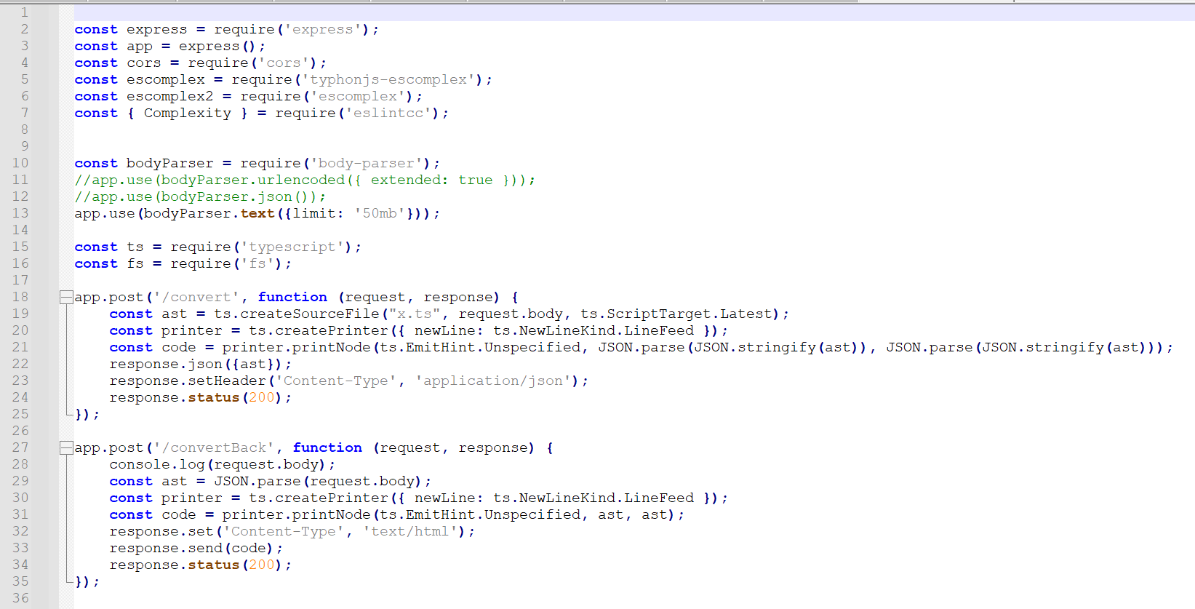

Slide 71
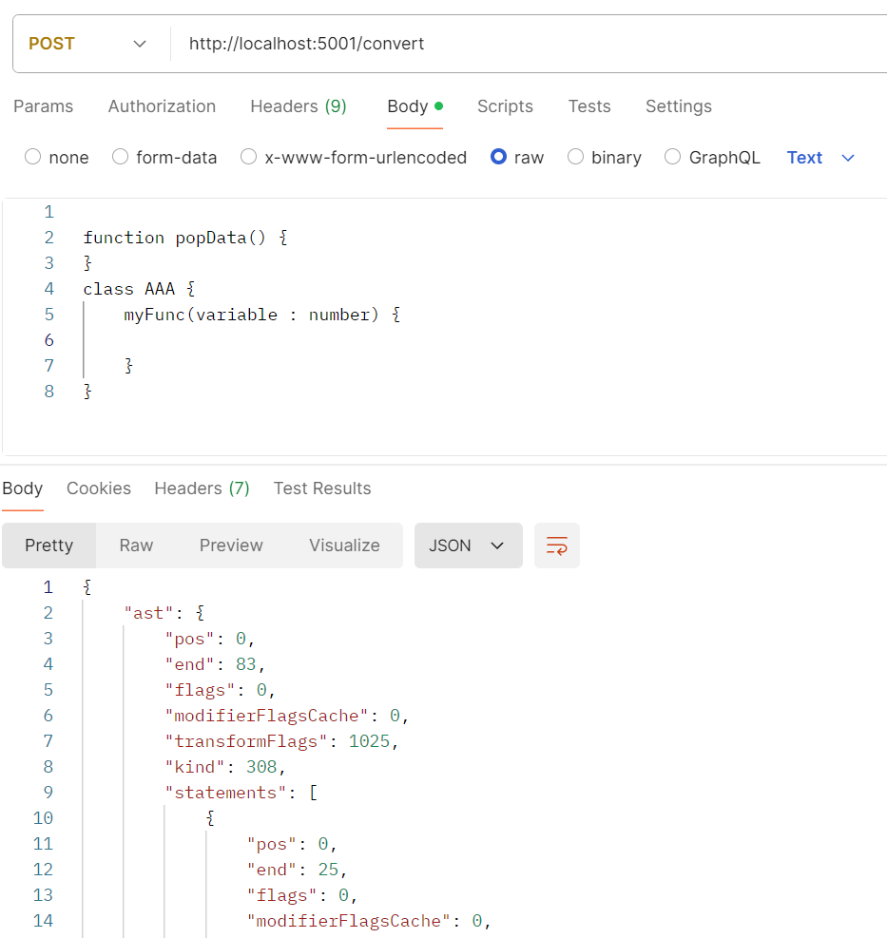
Convert
JavaScript into AST
POST http://localhost:5001/convert
function popData() {
}
class AAA {
myFunc(variable : number) {
}
}

Slide 72
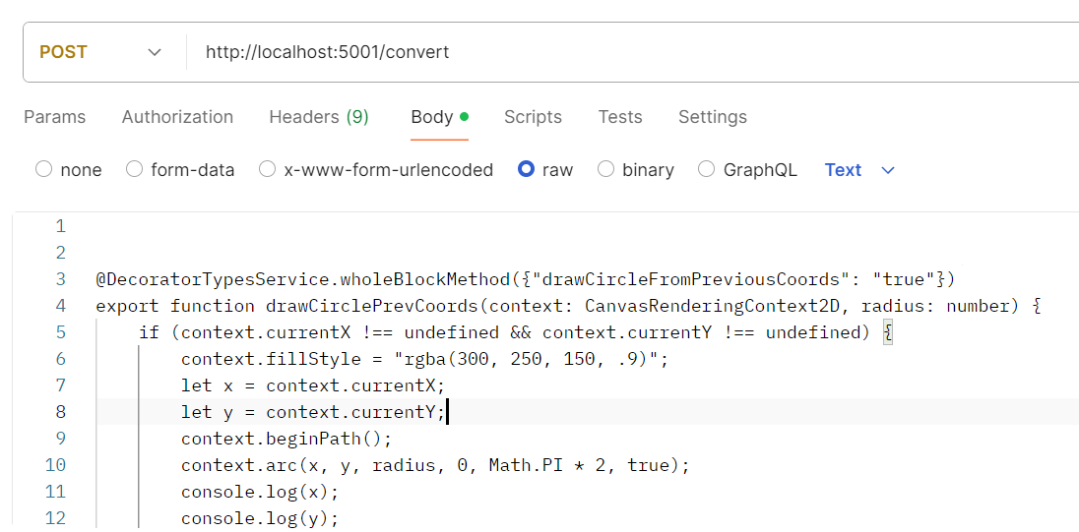
Convert TypeScript into AST
POST http://localhost:5001/convert
@DecoratorTypesService.wholeBlockMethod({"drawCircleFromPreviousCoords": "true"})
export function drawCirclePrevCoords(context: CanvasRenderingContext2D, radius: number) {
if (context.currentX !== undefined && context.currentY !== undefined) {
context.fillStyle = "rgba(300, 250, 150, .9)";
let x = context.currentX;
let y = context.currentY;
context.beginPath();
context.arc(x, y, radius, 0, Math.PI * 2, true);
console.log(x);
console.log(y);
context.closePath();
context.fill();
}
}

Slide 73
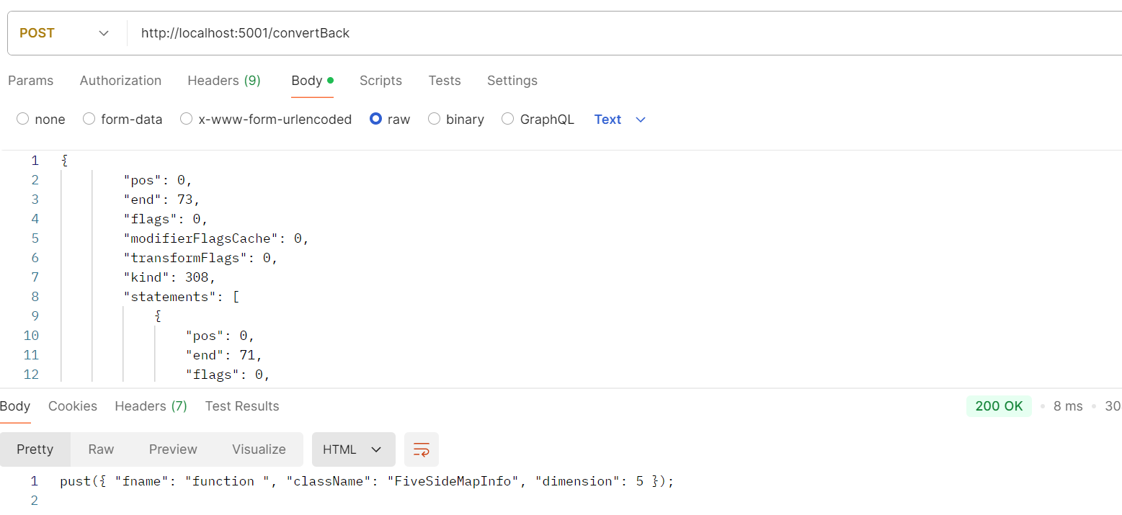
Convert
From AST
Back Into
Code
POST http://localhost:5001/convertBack
{"pos":0,"end":73,"flags":0,"modifierFlagsCache":0,"transformFlags":0,"kind":308,"statements":[{"pos":0,"end":71,"flags":0,"modifierFlagsCache":0,"transformFlags":0,"kind":241,"expression":{"pos":0,"end":71,"flags":0,"modifierFlagsCache":0,"transformFlags":0,"kind":210,"expression":{"pos":0,"end":4,"flags":0,"modifierFlagsCache":0,"transformFlags":0,"kind":79,"escapedText":"pust"},"arguments":[{"pos":5,"end":70,"flags":0,"modifierFlagsCache":0,"transformFlags":0,"kind":207,"properties":[{"pos":6,"end":25,"flags":0,"modifierFlagsCache":0,"transformFlags":0,"kind":299,"name":{"pos":6,"end":13,"flags":0,"modifierFlagsCache":0,"transformFlags":0,"kind":10,"text":"fname","hasExtendedUnicodeEscape":false},"initializer":{"pos":14,"end":25,"flags":0,"modifierFlagsCache":0,"transformFlags":0,"kind":10,"text":"function","hasExtendedUnicodeEscape":false}},{"pos":26,"end":55,"flags":0,"modifierFlagsCache":0,"transformFlags":0,"kind":299,"name":{"pos":26,"end":37,"flags":0,"modifierFlagsCache":0,"transformFlags":0,"kind":10,"text":"className","hasExtendedUnicodeEscape":false},"initializer":{"pos":38,"end":55,"flags":0,"modifierFlagsCache":0,"transformFlags":0,"kind":10,"text":"FiveSideMapInfo","hasExtendedUnicodeEscape":false}},{"pos":56,"end":69,"flags":0,"modifierFlagsCache":0,"transformFlags":0,"kind":299,"name":{"pos":56,"end":67,"flags":0,"modifierFlagsCache":0,"transformFlags":0,"kind":10,"text":"dimension","hasExtendedUnicodeEscape":false},"initializer":{"pos":68,"end":69,"flags":0,"modifierFlagsCache":0,"transformFlags":0,"kind":8,"text":"5","numericLiteralFlags":0}}],"multiLine":false}]}}],"endOfFileToken":{"pos":71,"end":73,"flags":0,"modifierFlagsCache":0,"transformFlags":0,"kind":1},"fileName":"x.ts","text":"pust({\"fname\":\"function\",\"className\":\"FiveSideMapInfo\",\"dimension\":5})\r\n","languageVersion":99,"languageVariant":0,"scriptKind":3,"isDeclarationFile":false,"hasNoDefaultLib":false,"bindDiagnostics":[],"pragmas":{},"referencedFiles":[],"typeReferenceDirectives":[],"libReferenceDirectives":[],"amdDependencies":[],"nodeCount":15,"identifierCount":1,"identifiers":{},"parseDiagnostics":[]}

Slide 74
AST
{
"pos": 0,
"end": 73,
"flags": 0,
"modifierFlagsCache": 0,
"transformFlags": 0,
"kind": 308,
"statements":
[
{
"pos": 0,
"end": 71,
...
"expression": {
"pos": 0,
"end": 71,
...
"expression": {
"pos": 0,
"end": 4,
...
"escapedText": "pust"
},
"arguments": [
{
"pos": 5,
"end": 70,
The name of called function
First argument = whole JSON
}
],
"text": "pust({\"fname\":\"function \",\"className\":\"FiveSideMapInfo\",\"dimension\":5})\r\n",
...
"parseDiagnostics": []
}

Slide 75
Restrictions of using aspects in typescript
BRIEFNESS
How easy, how exactly,
and without
complications it is possible
to use given tool
MATURITY
INVASIVENESS
All abilities and possibilities of
the whole functionality
provided by a given library
how well aspects are separated
from the rest of the code
Komponent / Nástroj | AspectScript | AOJS | AspectJS
Invazívnosť (invasiveness) | - | + | -
Stručnosť (briefness) | ++ | + | ++
Vyspelosť (maturity) | ++ | - | -
Wenhao Huang, Chengwan He, and Zheng Li. 2015.
A Comparison of Implementations for Aspect-Oriented
JavaScript:. Zhengzhou, China.
https://doi.org/10.2991/csic-15.2015.9
Ricardo Sá Loureiro Ferreira da Silva. 2019. Aspect-Oriented Programming for Javascript using the Lara Language. Dissertation thesis. Universidade do Porto, Porto.
The comparison of AOP tools
(Huang et al. 2015)

Slide 76
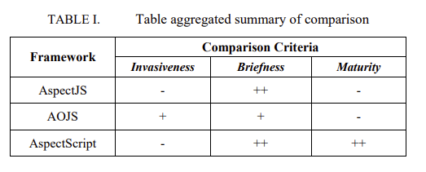
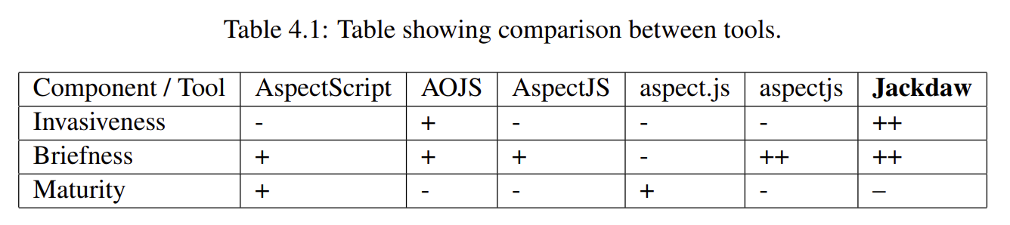
Wenhao Huang, Chengwan He, and Zheng Li. 2015.
A Comparison of Implementations for Aspect-Oriented
JavaScript:. Zhengzhou, China.
https://doi.org/10.2991/csic-15.2015.9
Taken from: SÁ LOUREIRO FERREIRA DA SILVA, Ricardo, 2019. Aspect-Oriented Programming for Javascript using the Lara Language. Porto. Dissertation thesis. Universidade do Porto.

Slide 77
Aspect C++
Guide for Windows, especially Windows 11
For IDE try: https://acdt.aspectc.org/
Based on old Eclipse Neon – not worked for me

Slide 78
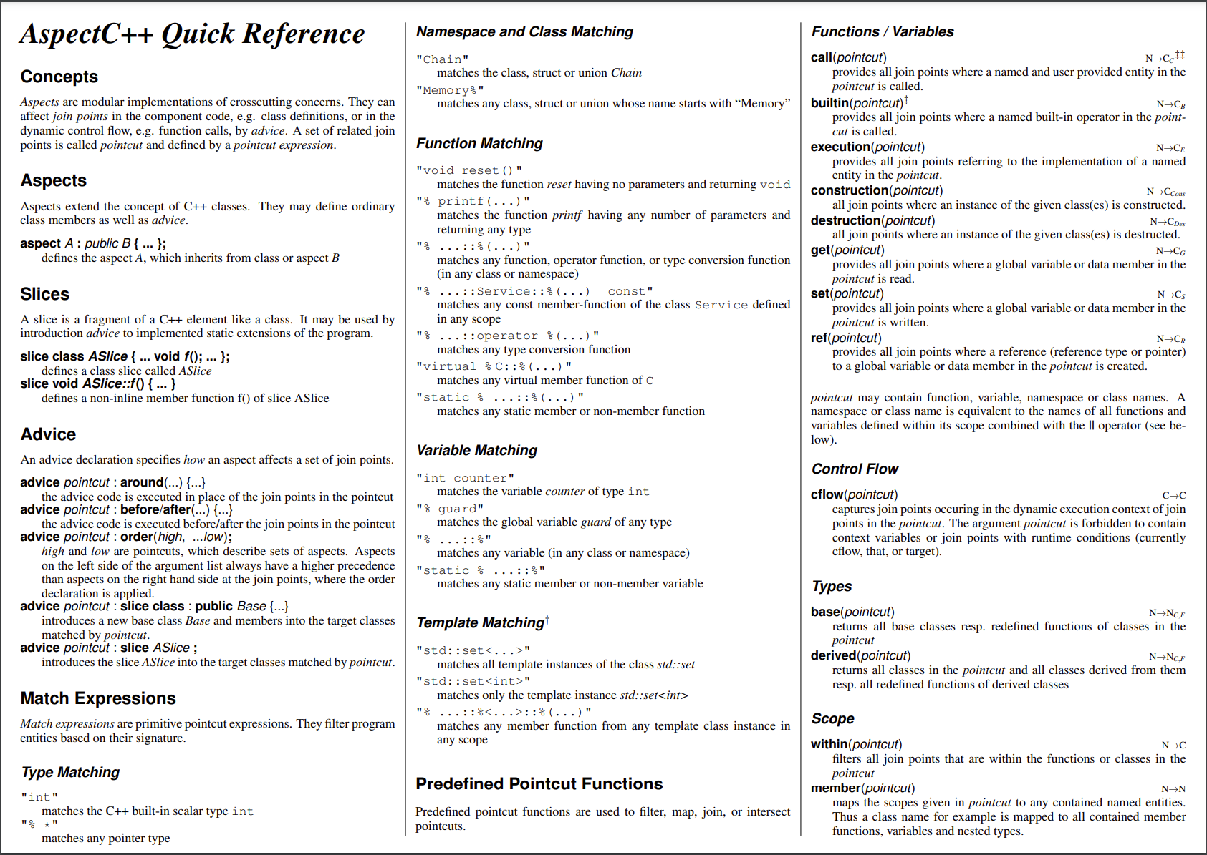
Source: https://www.aspectc.org/doc/ac-quickref.pdf

Slide 79
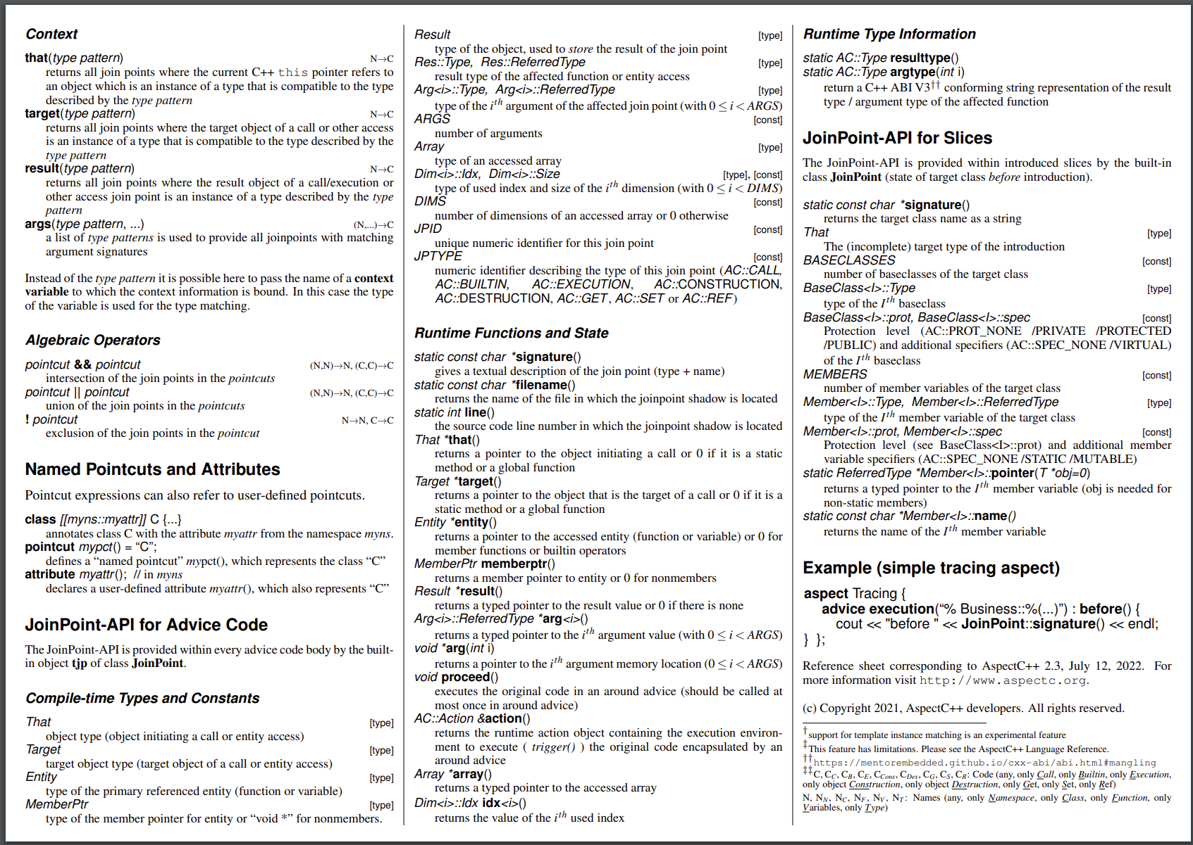
Source: https://www.aspectc.org/doc/ac-quickref.pdf

Slide 80
Preparation for Windows
Some steps will differ on Unix based systems
1. Download AspectC
2. Download and install G++ compiler
3. Prepare C/C++ source files and headers
4. Prepare AspectC headers
5. Compile and weave them together
6. Launch executable

Slide 81
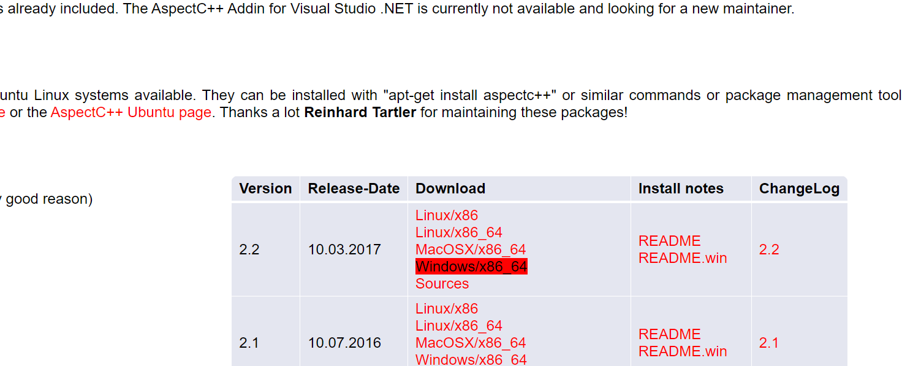
C++ aspect-oriented Weaving tool - AspectC
1. Download from: https://www.aspectc.org/Download.php
2. Extract to chosen source directory

Slide 82
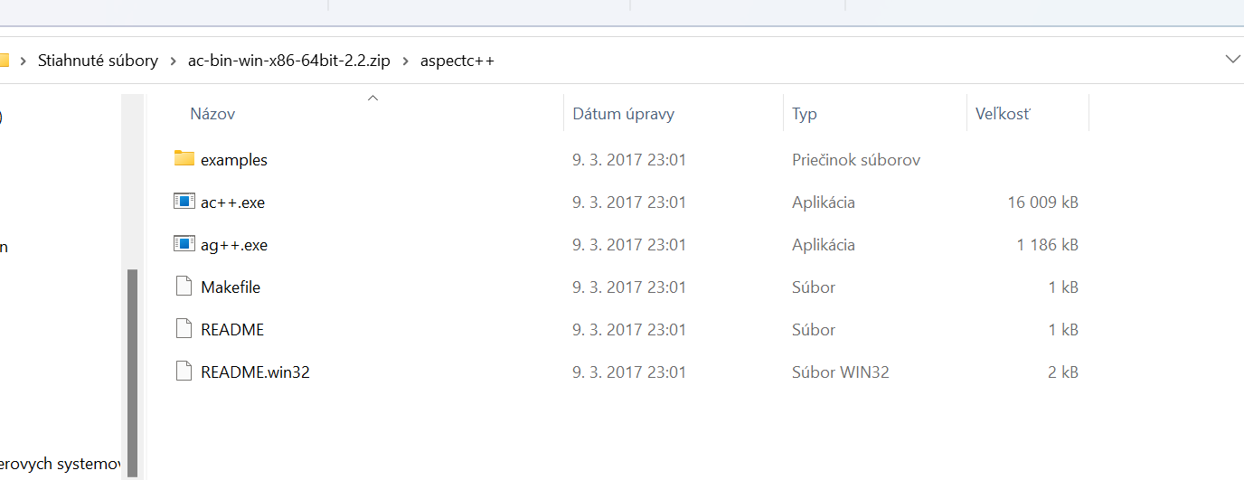
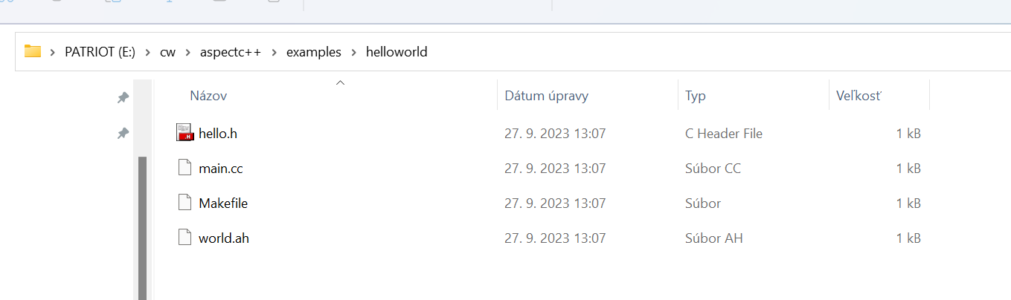
Working examples
Aspect-oriented
weaving tool
Frontend/Utility to AspectJ weaver
3. Copy some
working examples
here

Slide 83
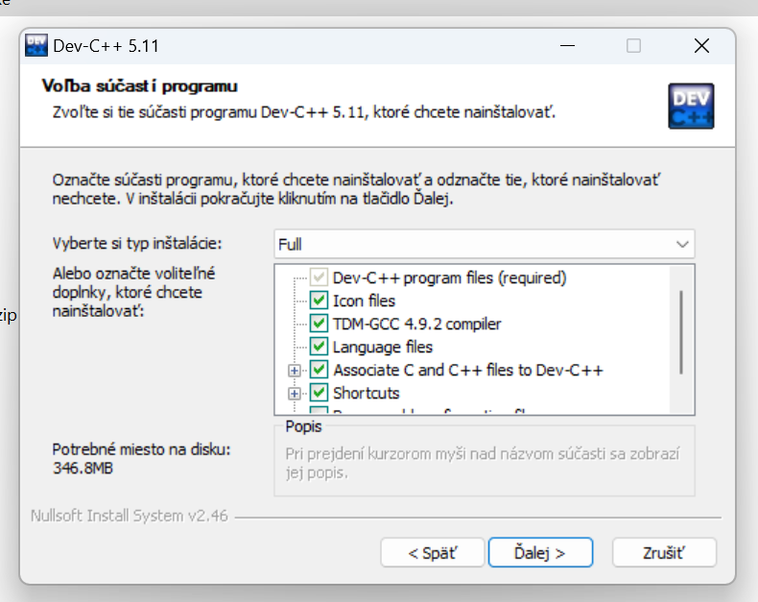
G++ compiler
I recommend installing DevC++ Orwell update – works on Windows 11
  G++ is included
Available at: http://orwelldevcpp.blogspot.com
  With Additional information
Download and install:
https://sourceforge.net/projects/orwelldevcpp/
Click full installation

Slide 84
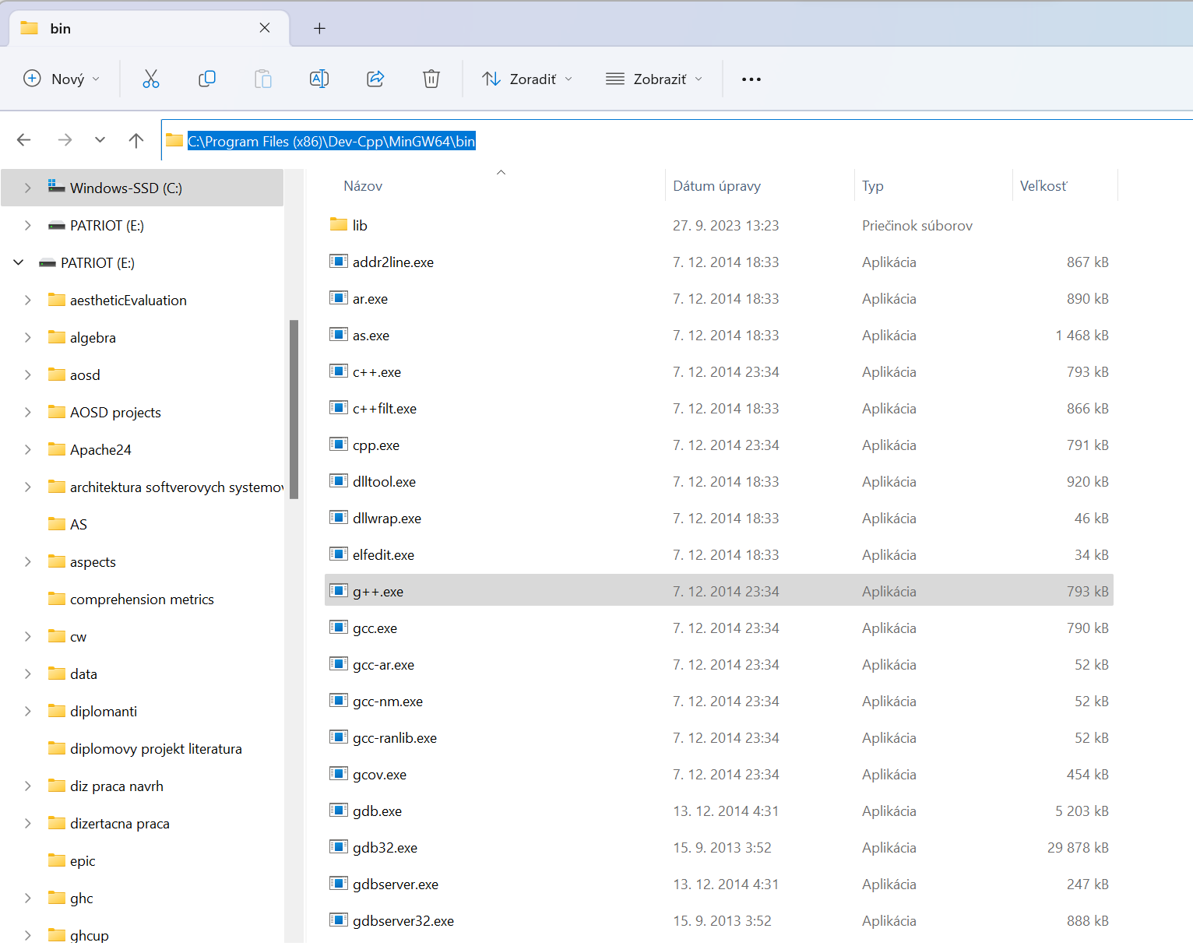
Find path to your G++ compiler
Optionally you can add
it to you path/ system path
C:\Program Files (x86)\Dev-Cpp\MinGW64\bin

Slide 85
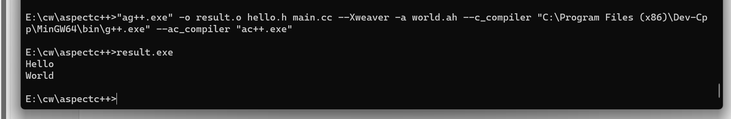
Working example
Header file: hello.h
C/C++ source code: main.cc
AspectC++ header: world.ah

Slide 86
#ifndef __HELLO_H__
#define__HELLO_H__
#include <iostream>
void hello(){
std::cout << "Hello" << std::endl;
}
#endif
#include "hello.h"
int main(){
hello(); //print "Hello"
return 0;
}
Header file: hello.h
C/C++ source code:
main.cc
#ifndef __WORLD_AH__
#define __WORLD_AH__
#include <iostream>
aspect World {
advice execution("void hello()") : after() {
//print "World" after execution of the 'hello()‘ function
std::cout << "World" << std::endl;
}
};
#endif
AspectC++ header: world.ah

Slide 87
Compilling and Weaving the program
More information in: https://www.aspectc.org/doc/ag-man.pdf
"ag++.exe" -o result.exe hello.h main.cc --Xweaver -a world.ah --c_compiler "C:\Program Files (x86)\Dev-Cpp\MinGW64\bin\g++.exe" --ac_compiler "ac++.exe"
Aspecs have been applied – Successfully done!

Slide 88
Analysis of AspectC utility
C/C++ source files
– including headers
Program name
Resulting executable
"ag++.exe"
-o result.exe hello.h main.cc
--Xweaver -a world.ah
--c_compiler "C:\Program Files (x86)\Dev-Cpp\MinGW64\bin\g++.exe"
--ac_compiler "ac++.exe"
Path to g++
compiler
AspectC headers
Path to AspectC compiler

Slide 89
Related literature
Also for embedded systems,...
https://www.aspectc.org/Publications.php
https://www.aspectc.org/doc/aosd-2005-demo.pdf
Search also for:
  software product lines
  conditional compilation
  weaving
  Aspects, aspect-oriented tools

Slide 90
Decorators in Python
application to asynchronous functions
cosmos_db = CosmosDb("")
SECS_DISABLE_CACHED = 5
async def main(request: func.HttpRequest) -> func.HttpResponse:
data = request.route_params.get('data’)
data_values = await cosmos_db.get(data)
if data == 'first’:
result = await do_something(data, data_values, ['aaa', 'bbb’, 'ccc’])
elif report == 'second’:
result = await do_something(data, data_values, ['11', '22', '33’])
else:
result = await do_something(data, values, ['x', 'd'])
return func.HttpResponse(result)

Slide 91
Decorator applied on async function: Use in FAAS
Azure functions
def use_cache_decorator(function_to_do):
async def use_cache(report, data_values, value_array):
    if data_values is not None and data_values['time'] + SECS_DISABLE_CACHED > time.time():
    return data_values['value’]
    else:
    result_dict = dict()
    result_dict['id'] = report
    result_dict['value'] = await function_to_do(value_array)
    result_dict['time'] = time.time()
    response = await cosmos_db.upsert(result_dict)
    return response['value']
    return use_cache
Package in Python: azure-functions
@use_cache_decorator
async def do_something(item_ids: 'list[str]') -> str:
items = await MyAssets.get(item_ids)
result = calculate(items)
return f'result for [{", ".join(item_ids)}] = {result}'

Slide 92
References
Capabilities, Basics, Advanced topics and Application of AspectJ: The AspectJ in Action Laddad, Ramnivas, 2003. AspectJ in action: practical aspect-oriented programming. Greenwich, CT: Manning. ISBN 978-1-930110-93-9.
Dynamic Aspect-Oriented Programming in Java: The HotWave Experience: https://link.springer.com/chapter/10.1007/978-3-642-35551-6_3
CARDOSO, João M.P., Tiago CARVALHO, José G.F. COUTINHO, Wayne LUK, Ricardo NOBRE, Pedro DINIZ a Zlatko PETROV, 2012. LARA: an aspect-oriented programming language for embedded systems. V: Proceedings of the 11th annual international conference on Aspect-oriented Software Development - AOSD ’12 [online]. Potsdam, Germany: ACM Press, s. 179. ISBN 978-1-4503- 1092-5. Dostupné na: doi:10.1145/2162049.2162071
RASHID, Awais, Ana MOREIRA a Joāo ARAÚJO, 2003. Modularisation and composition of aspectual requirements. V: the 2nd international conference: Proceedings of the 2nd international conference on Aspect-oriented software development - AOSD ’03 [online]. Boston, Massachusetts: ACM Press, s. 11–20. ISBN 978-1-58113-660-9. Dostupné na: doi:10.1145/643603.643605
SÁ LOUREIRO FERREIRA DA SILVA, Ricardo. Aspect-Oriented Programming for Javascript using the Lara Language. Porto. Dissertation thesis. Universidade do Porto, 2019
WASHIZAKI, Hironori, Yoichi NAGAI, Rieko YAMAMOTO, Atsuto KUBO, Tomohiko MIZUMACHI, Kazuki EGUCHI, Yoshiaki FUKAZAWA, Nobukazu YOSHIOKA, Hideyuki KANUKA, Toshihiro KODAKA a Nobuhide SUGIMOTO, 2009. AOJS: aspect-oriented javascript programming framework for web development. V: Proceedings of the 8th workshop on Aspects, components, and patterns for infrastructure software - ACP4IS ’09 [online]. Charlottesville, Virginia, USA: ACM Press, s. 31. ISBN 978-1-60558-450-8. Dostupné na: doi:10.1145/1509276.1509285
TOLEDO, Rodolfo, Paul LEGER a Éric TANTER, 2010. AspectScript: expressive aspects for the web. V: Proceedings of the Eighth International Conference on AspectOriented Software Development - AOSD ’10 [online]. Rennes and Saint-Malo, France: ACM Press, s. 13 [cit. 18.5.2022]. ISBN 978-1-60558-958-9. Dostupné na: doi:10.1145/1739230.1739233
SOARES, Sérgio, Paulo BORBA a Eduardo LAUREANO, Distribution and persistence as aspects. Software: Practice and Experience [online]. 2006, roč. 36, č. 7, s. 711–759. ISSN 0038-0644, 1097-024X. Dostupné na: doi:10.1002/spe.715
SOARES, Sergio, Eduardo LAUREANO a Paulo BORBA. Implementing distribution and persistence aspects with aspectJ. ACM SIGPLAN Notices [online]. 2002, roč. 37, č. 11, s. 174–190. ISSN 0362-1340, 1558-1160. Dostupné na: doi:10.1145/583854.582437
HUANG, Wenhao, Chengwan HE a Zheng LI. A Comparison of Implementations for Aspect-Oriented JavaScript. 2015, Dostupné na: doi:10.2991/csic-15.2015.9
Flanagan, D.: canto-js: An improved api for the html canvas tag (2010)
Aspect-oriended recreation of design patterns, application of patterns: R. Miles, AspectJ cookbook, 1st ed. Sebastopol, CA; Farnham: O’Reilly Media, 2004.

Slide 93
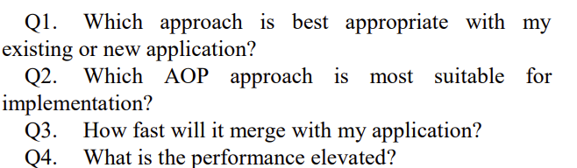
Taken from: KUMAR, Ravi a Munishwar RAI, 2019. A Comparative Study of AOP Approaches:
AspectJ, Spring AOP, JBoss AOP. 2019

